Slide 1

The Future of Democracy
Global Economic Trends (GET)
MiM@ISEG
20th October 2022

Slide 2
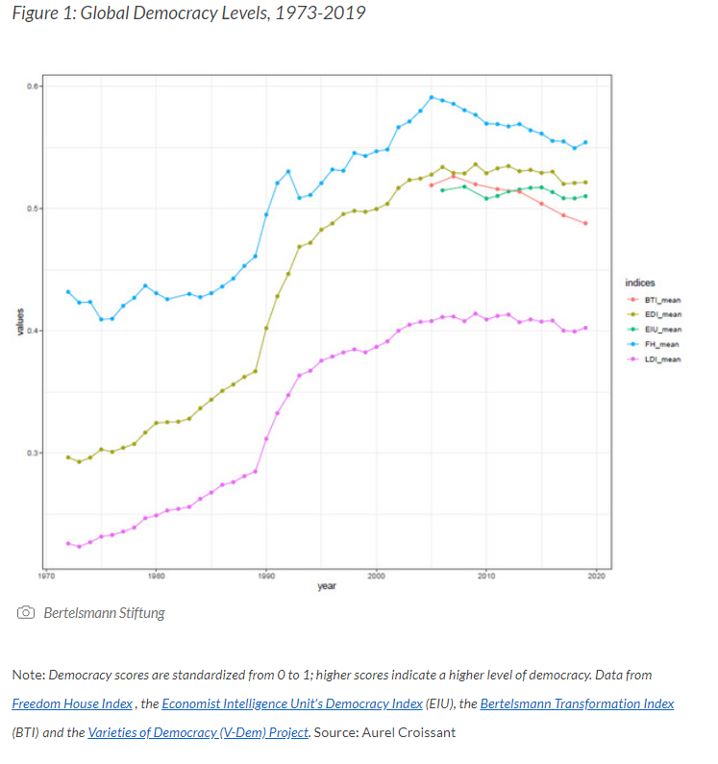
A trend in reverse…

Slide 3
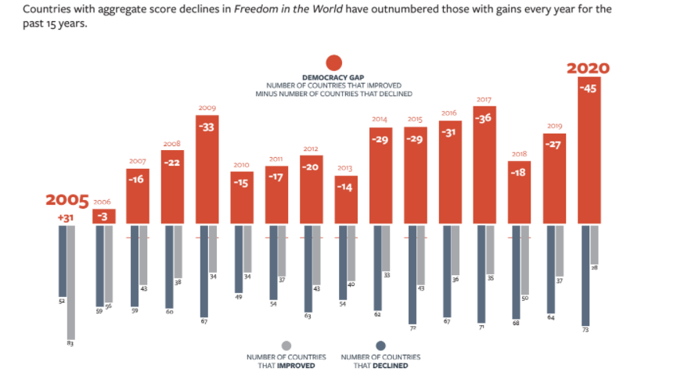
Source:Freedom House, 2021

Slide 4
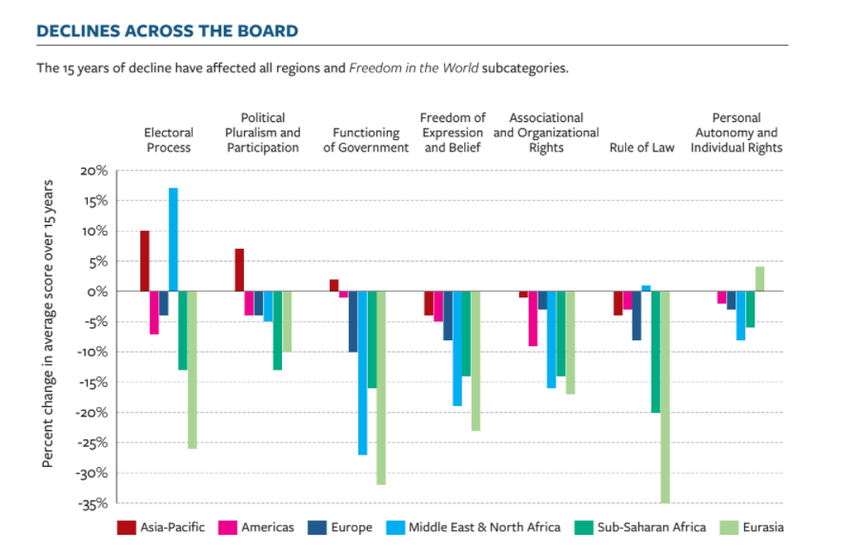
Source:Freedom House, 2021

Slide 5
PEW RESEARCH Fev. 2020

Slide 6
PEW RESEARCH Fev. 2020

Slide 7
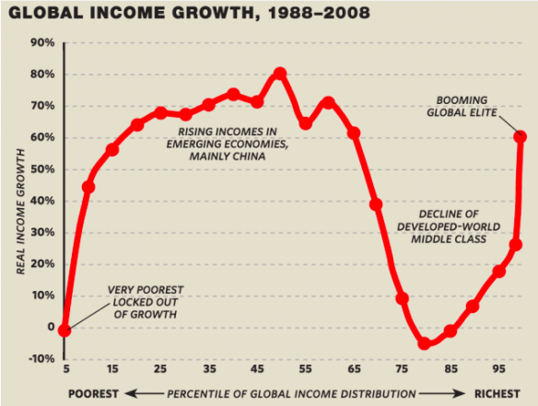

Slide 8
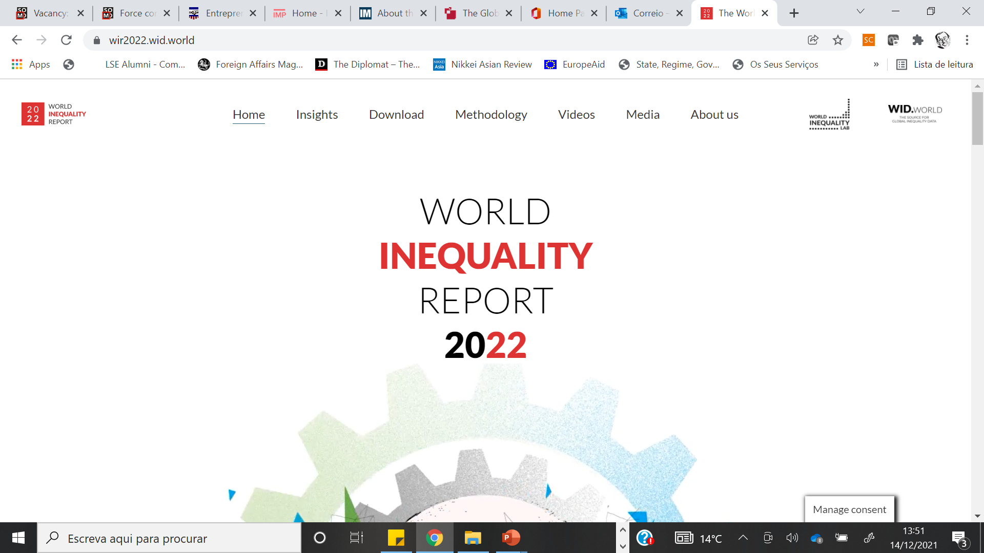

Slide 13

Financial Times,
18 de Setembro 2019

Slide 14
HUMAN RIGHTS UNDER CHALLENGE

Slide 15
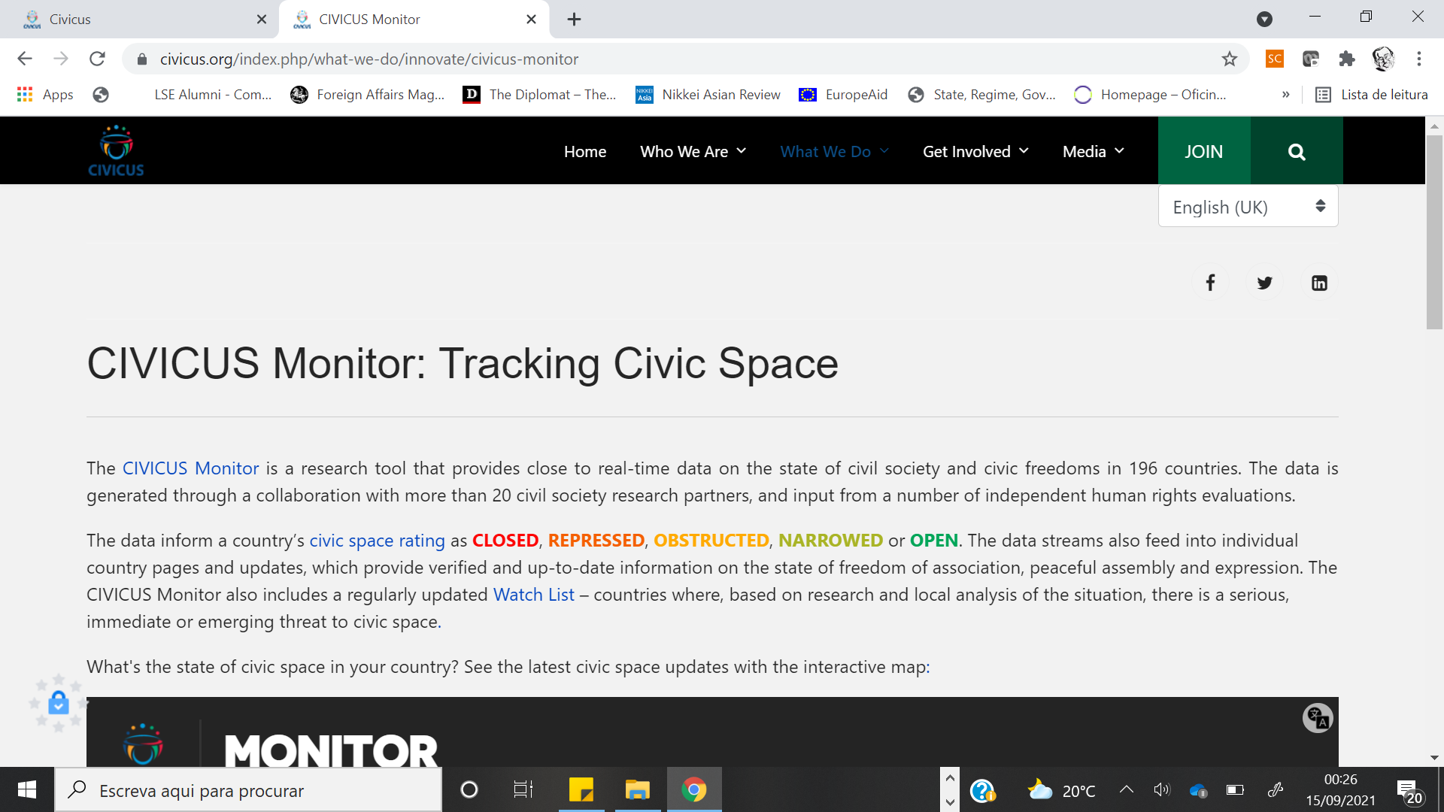

Slide 16
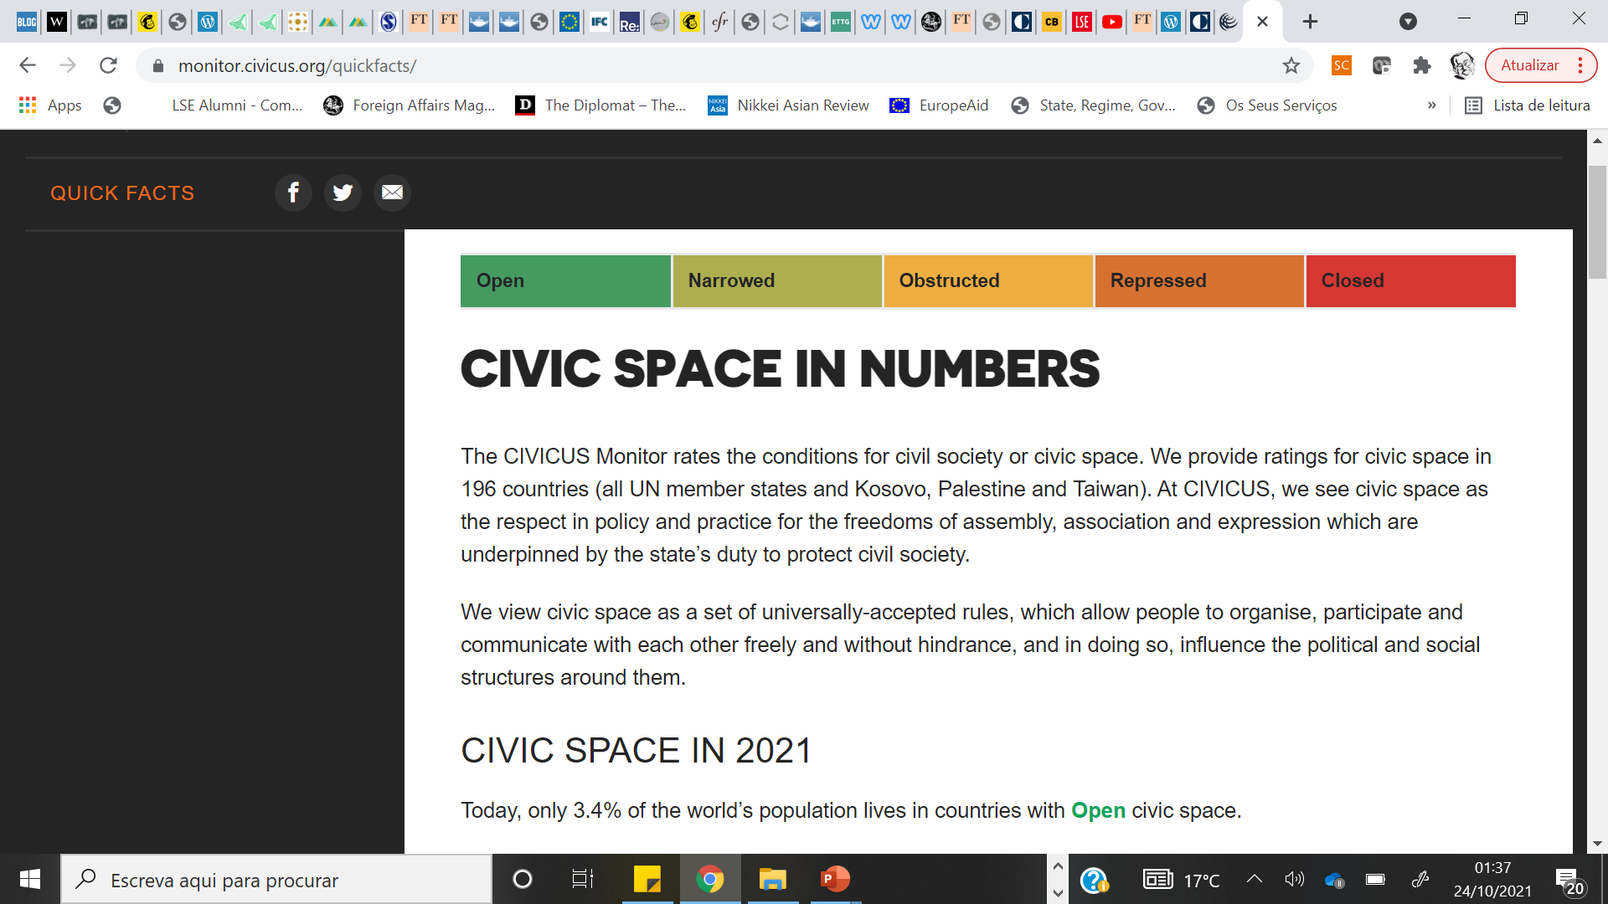

Slide 17
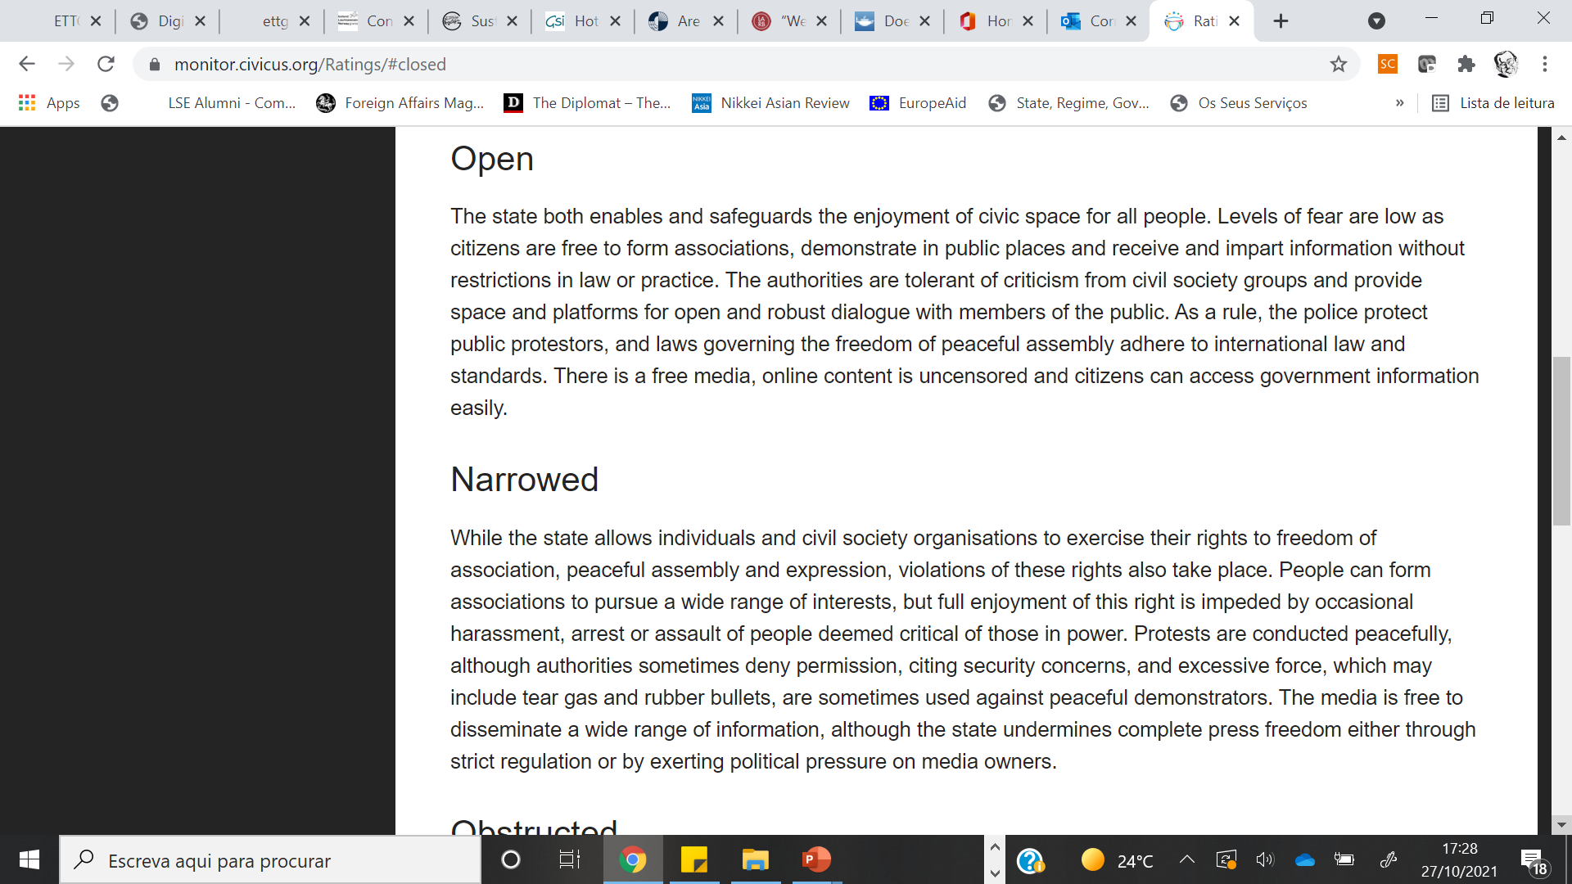


Slide 18



Slide 19
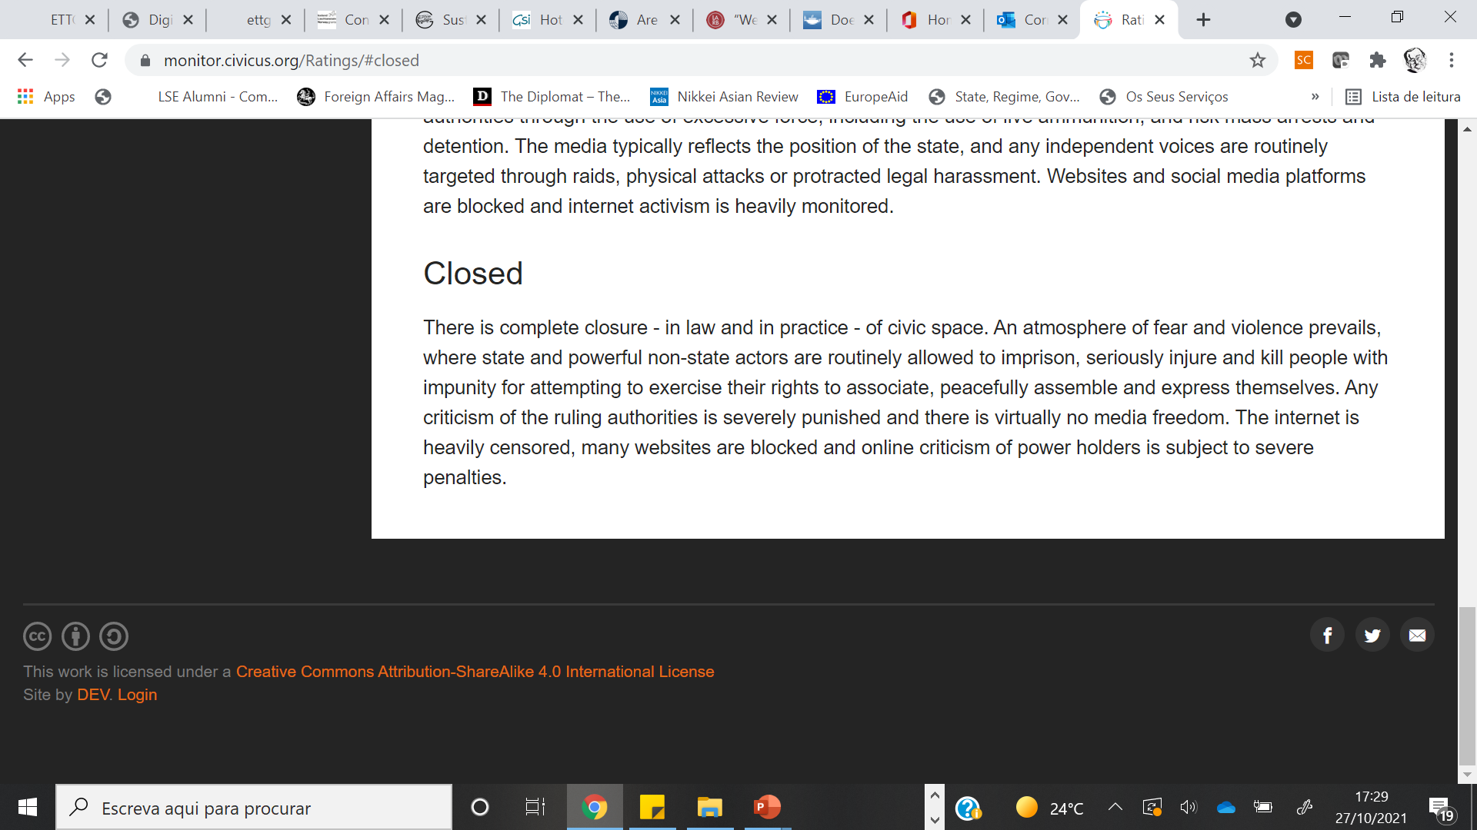


Slide 20
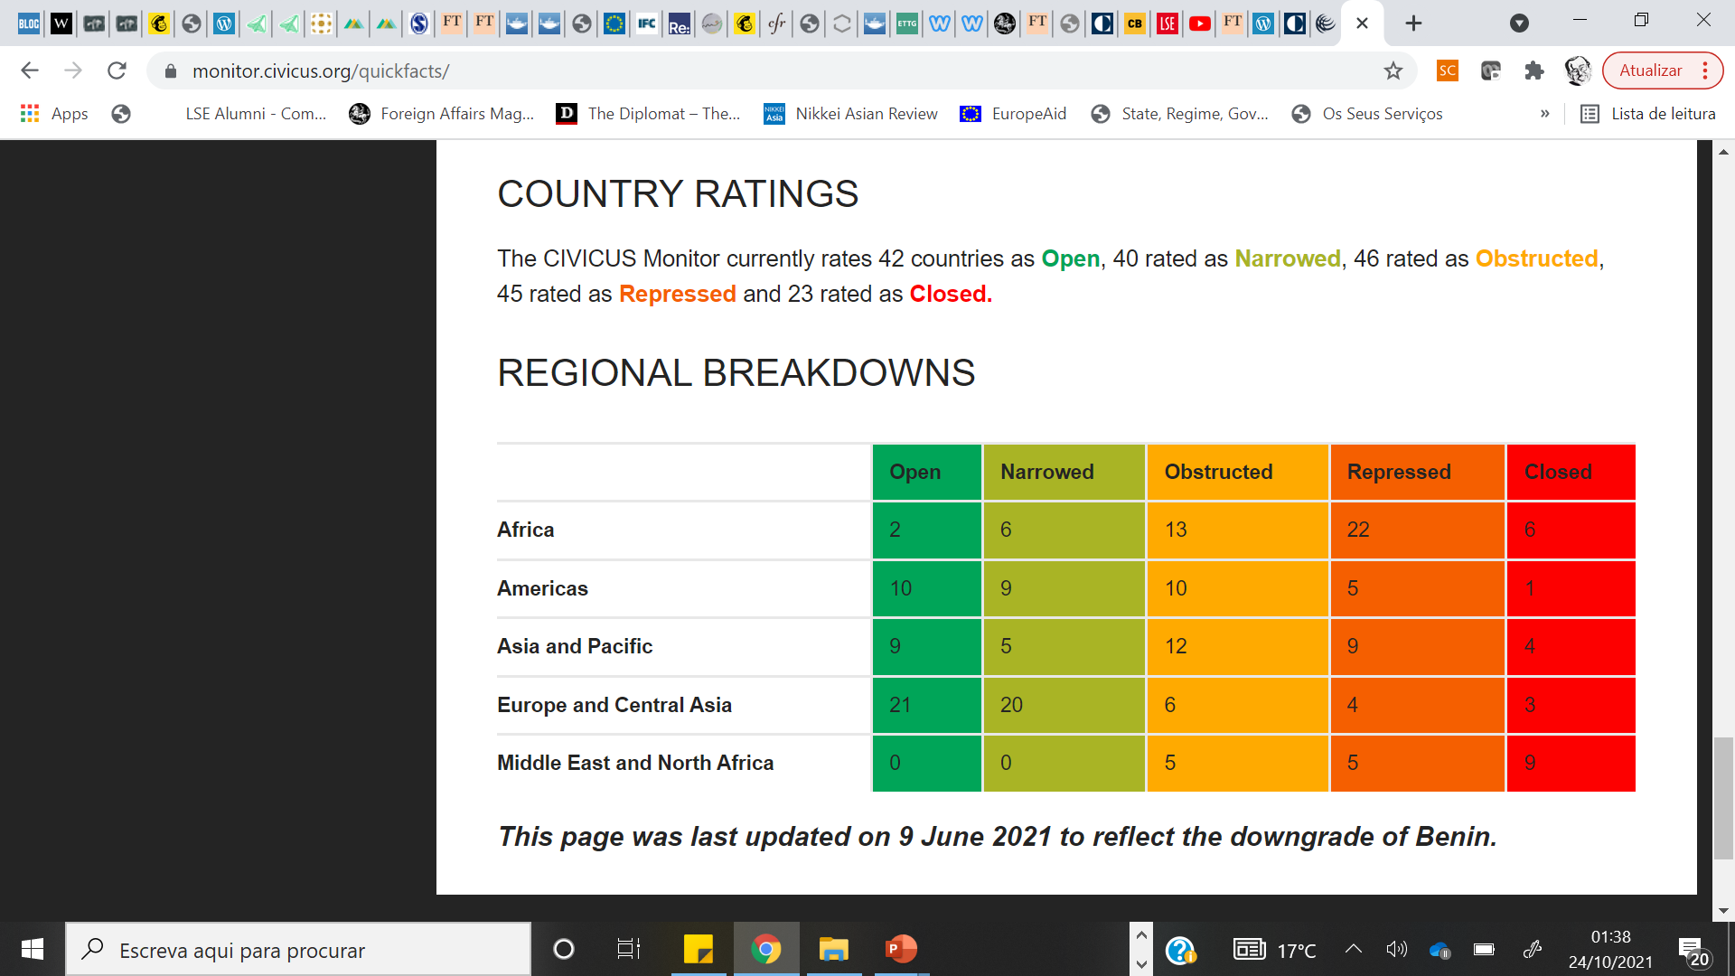

Slide 21
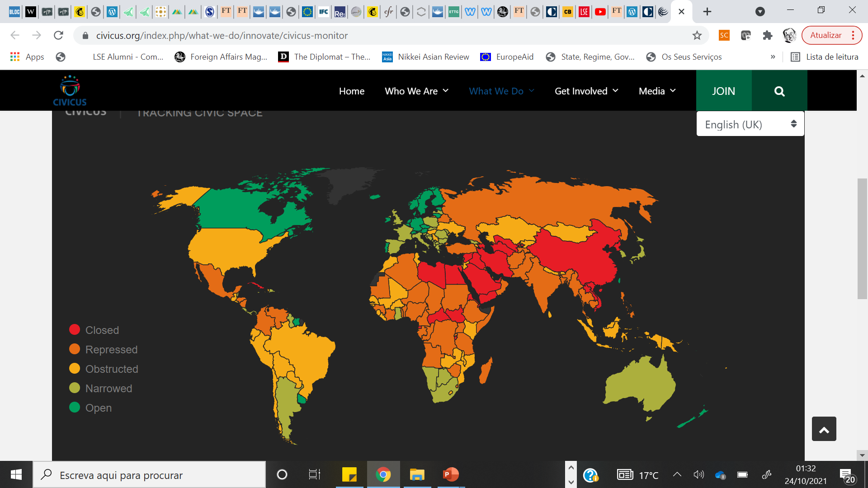

Slide 22
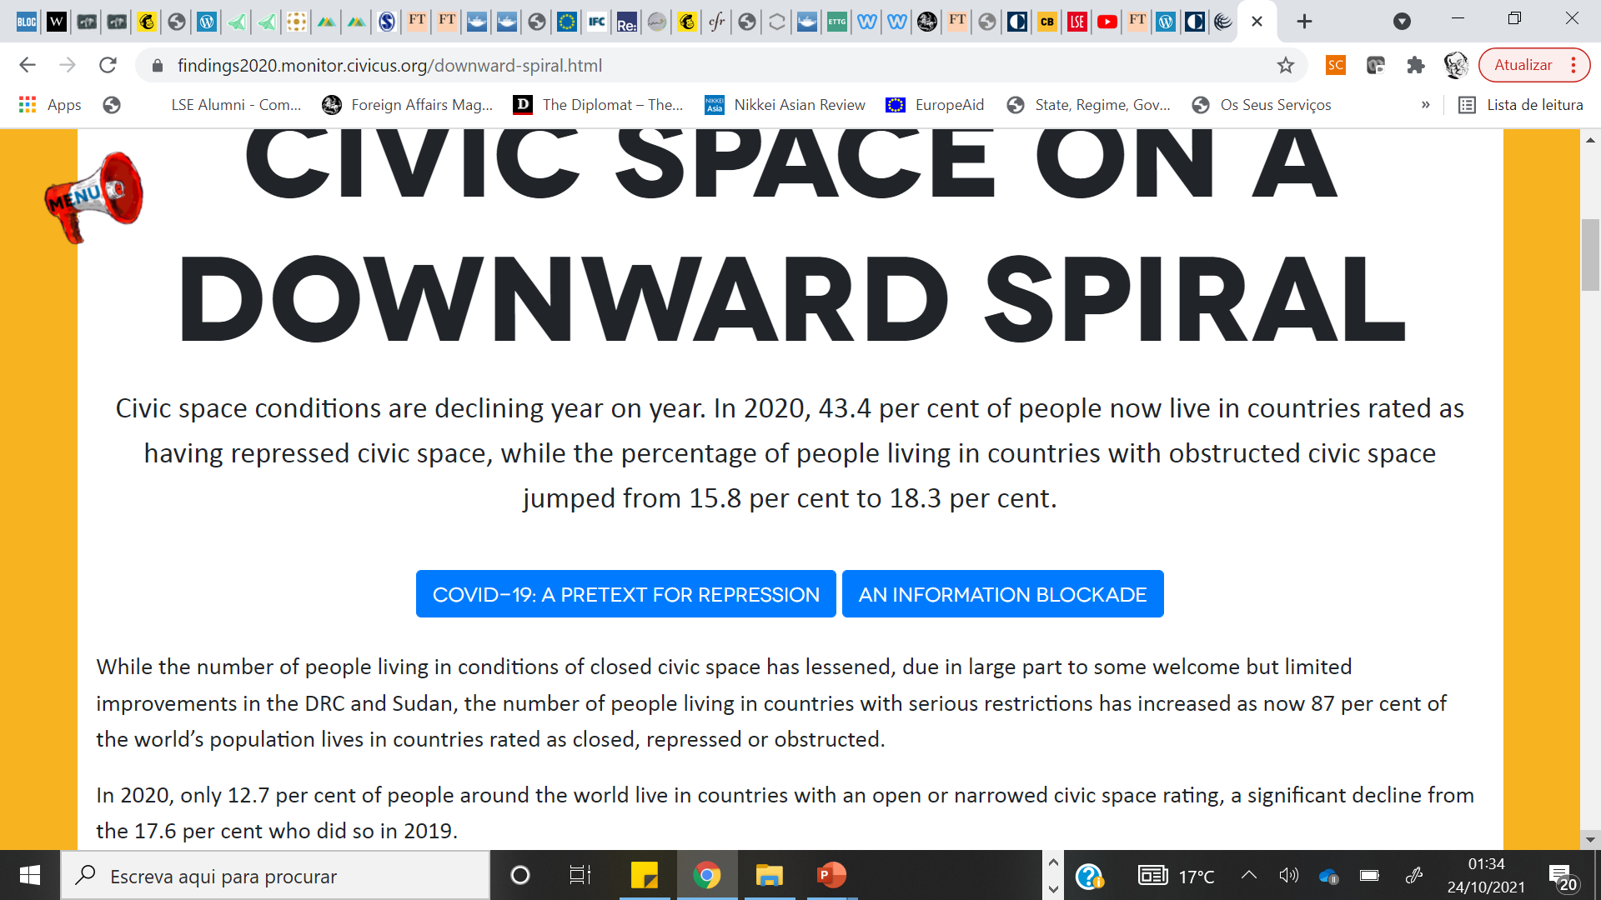

Slide 26
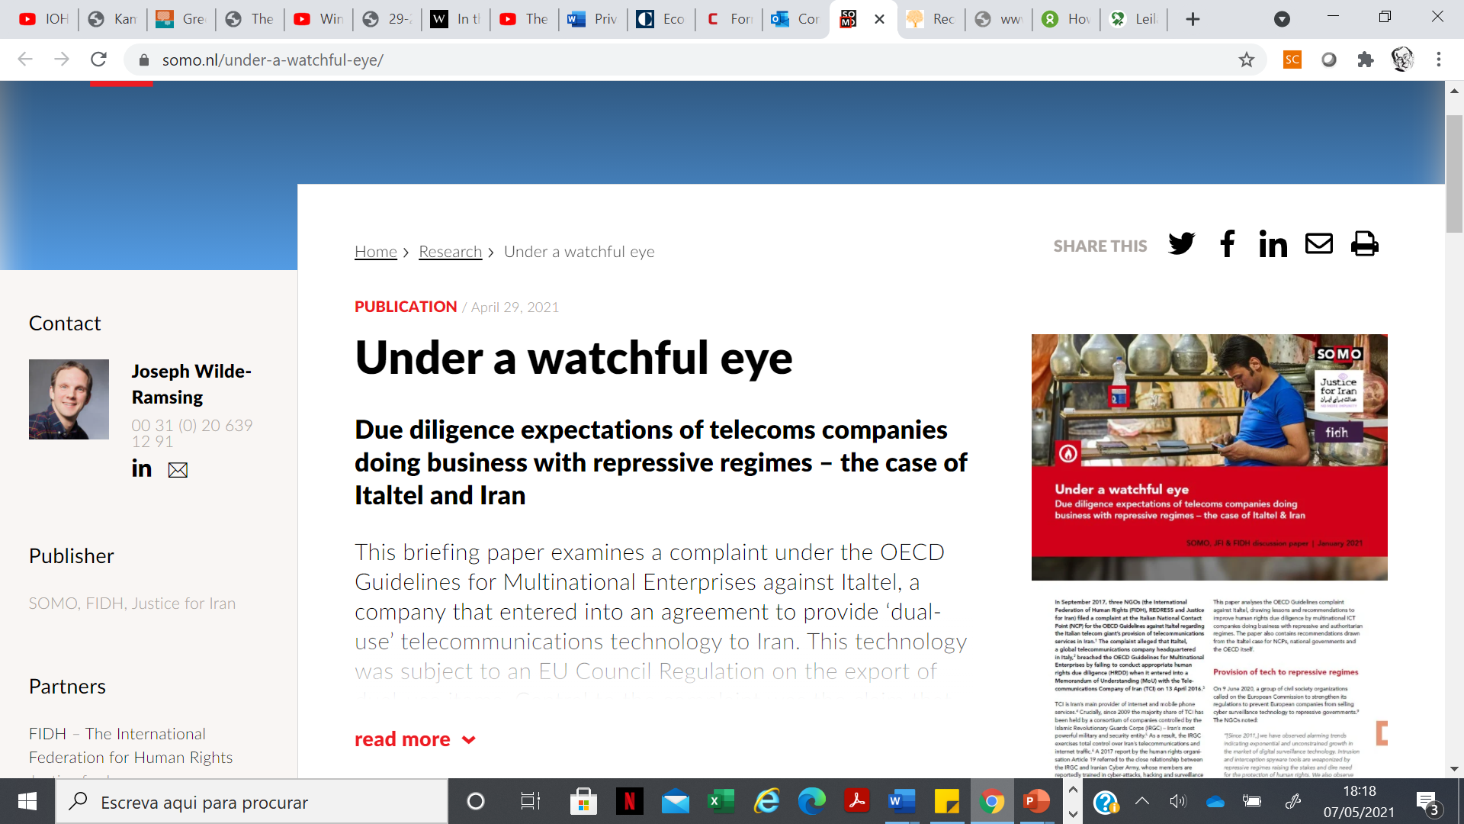

Slide 27


Slide 28
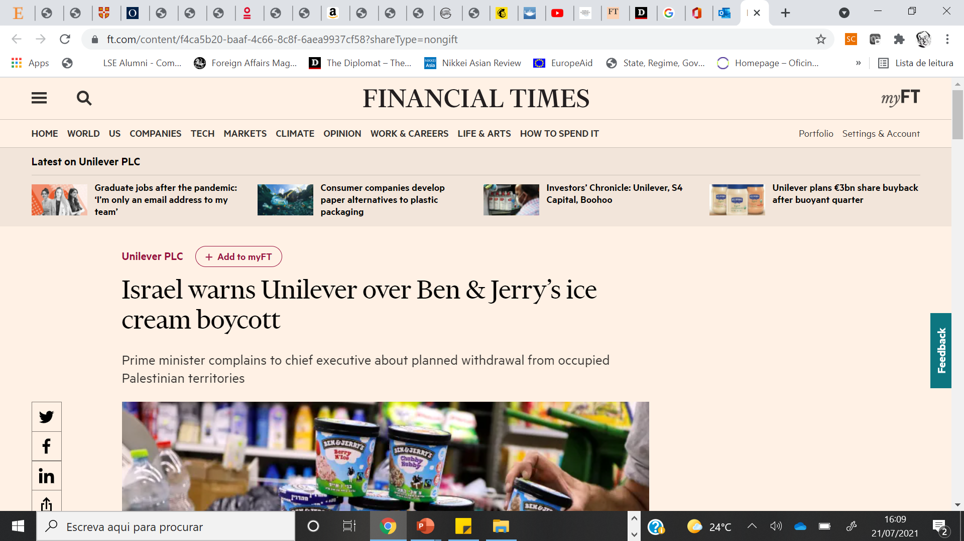

Slide 29
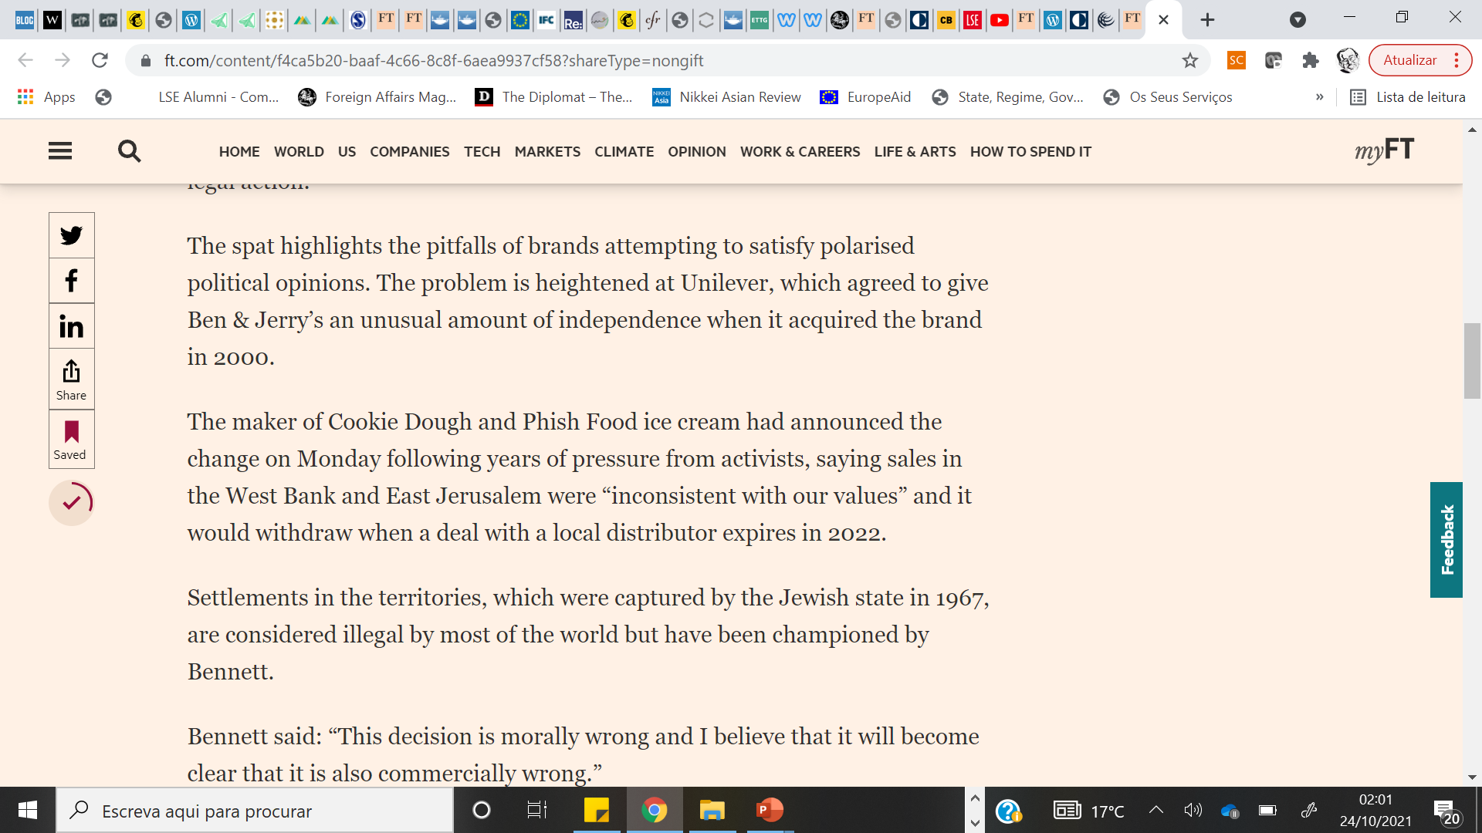

Slide 30
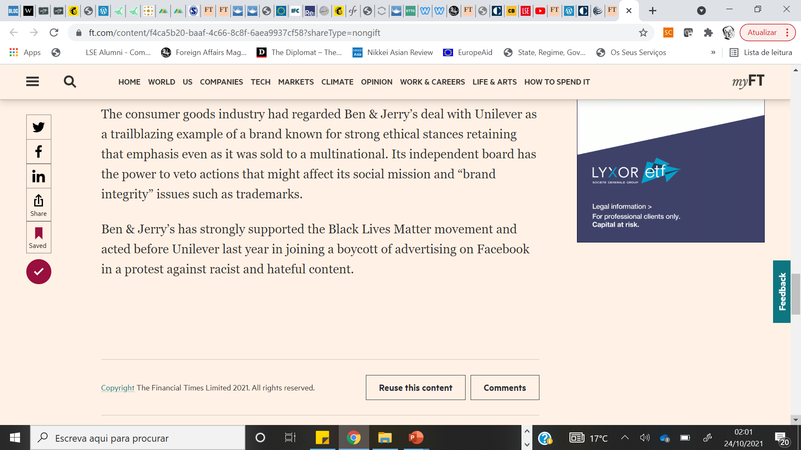


Slide 31
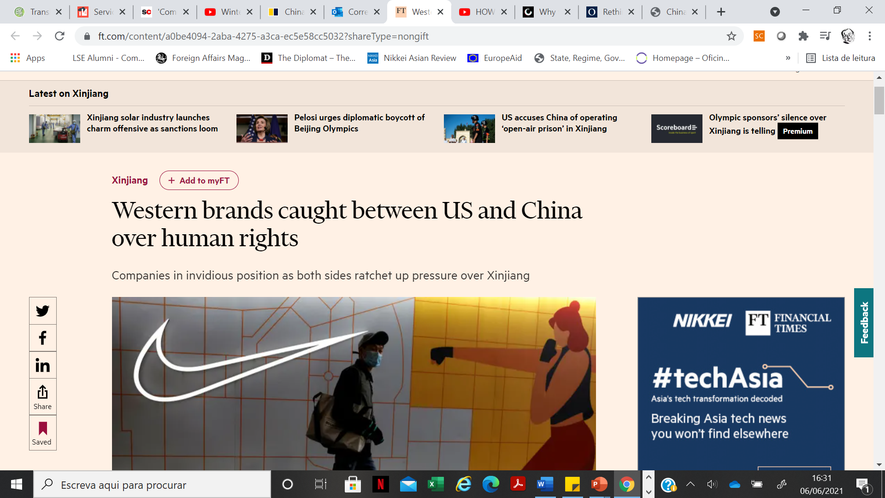

Slide 32
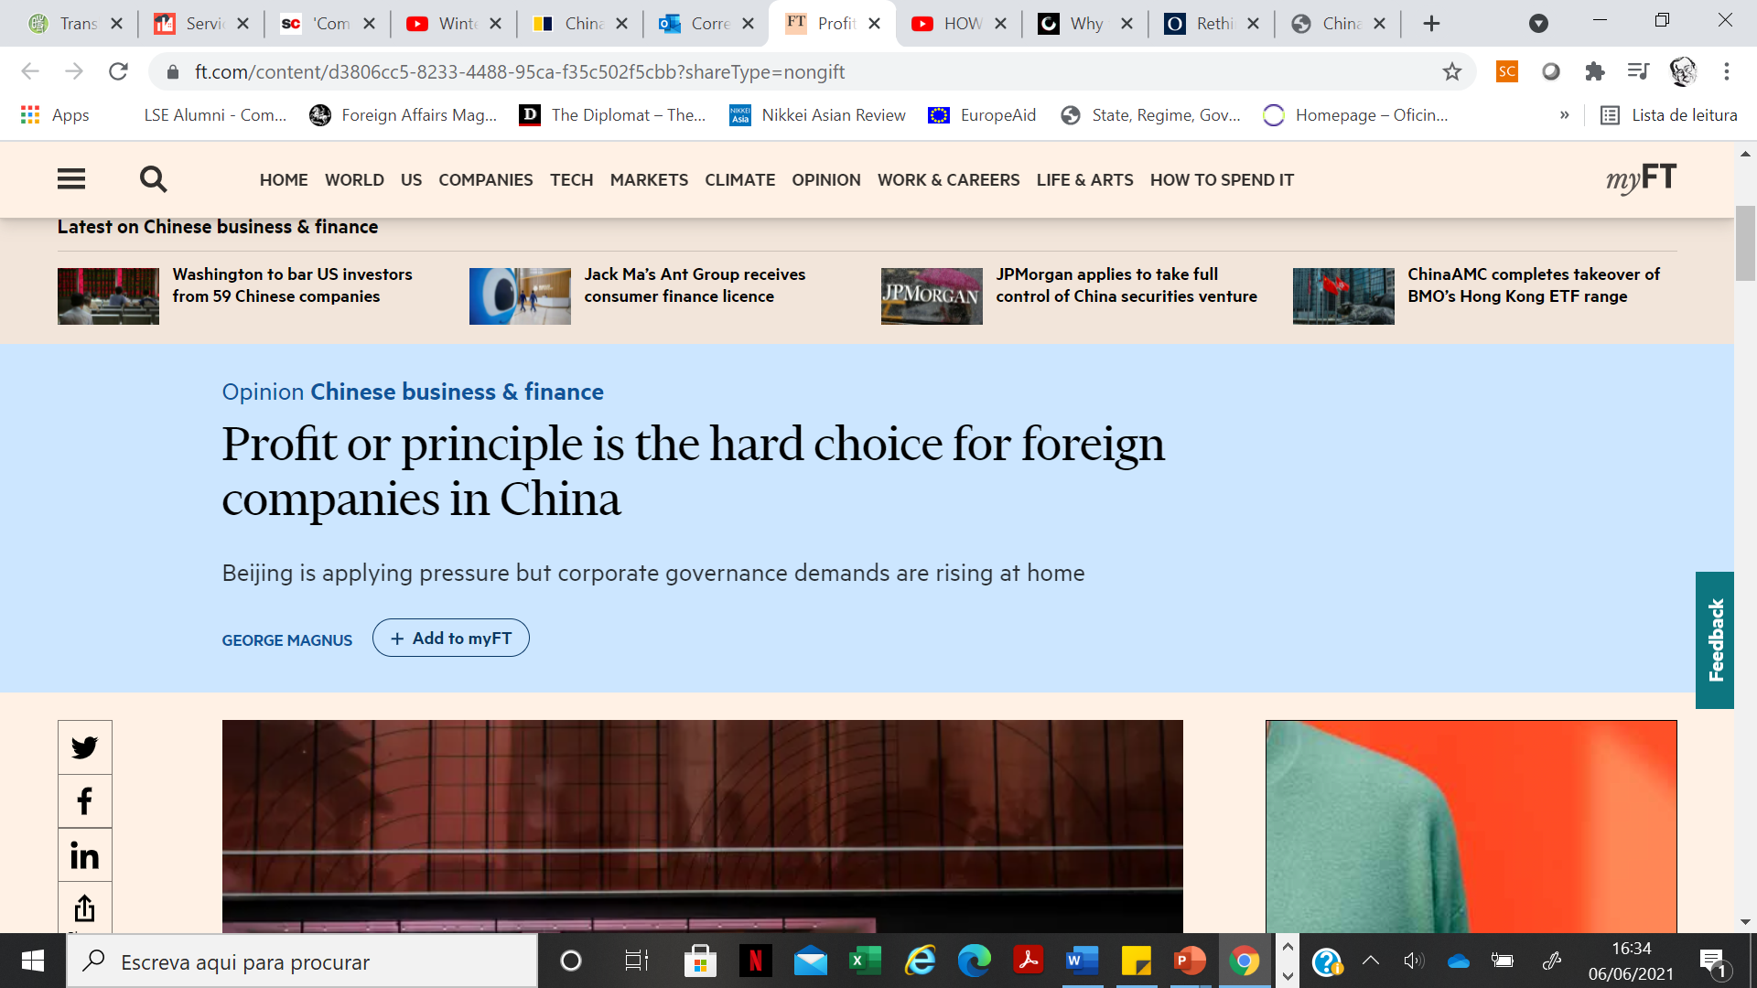

Slide 33
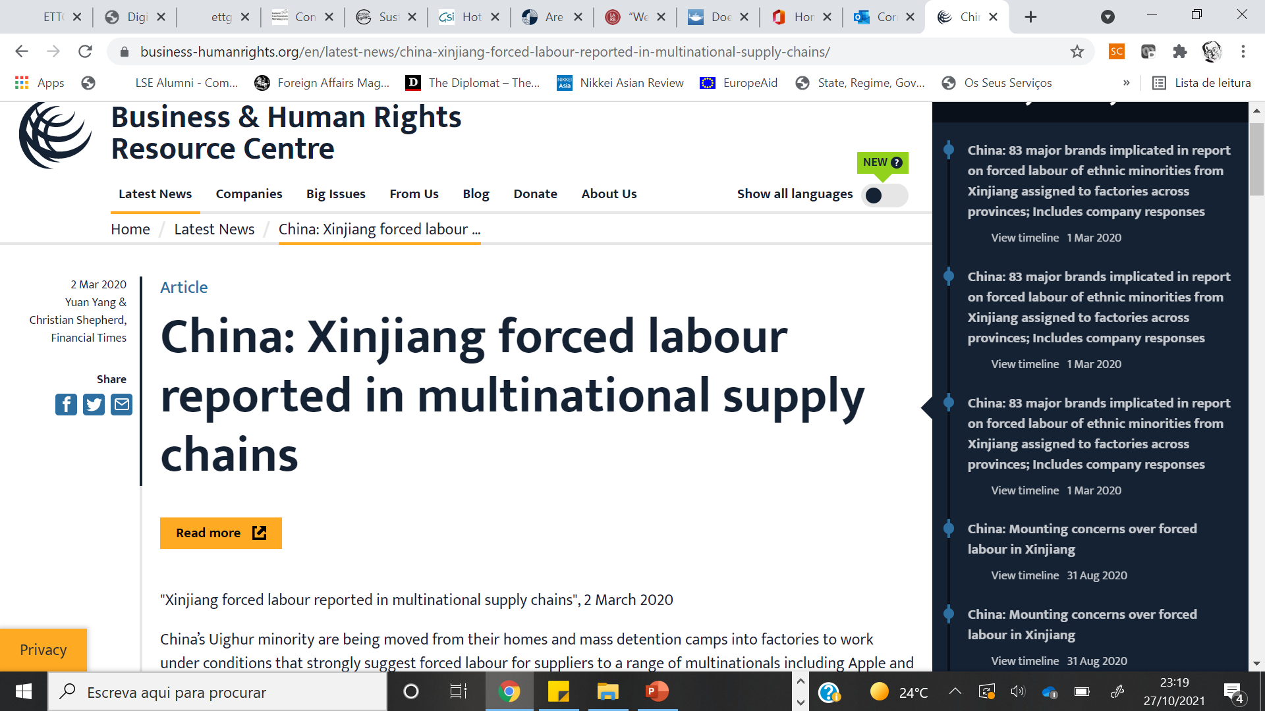

Slide 34
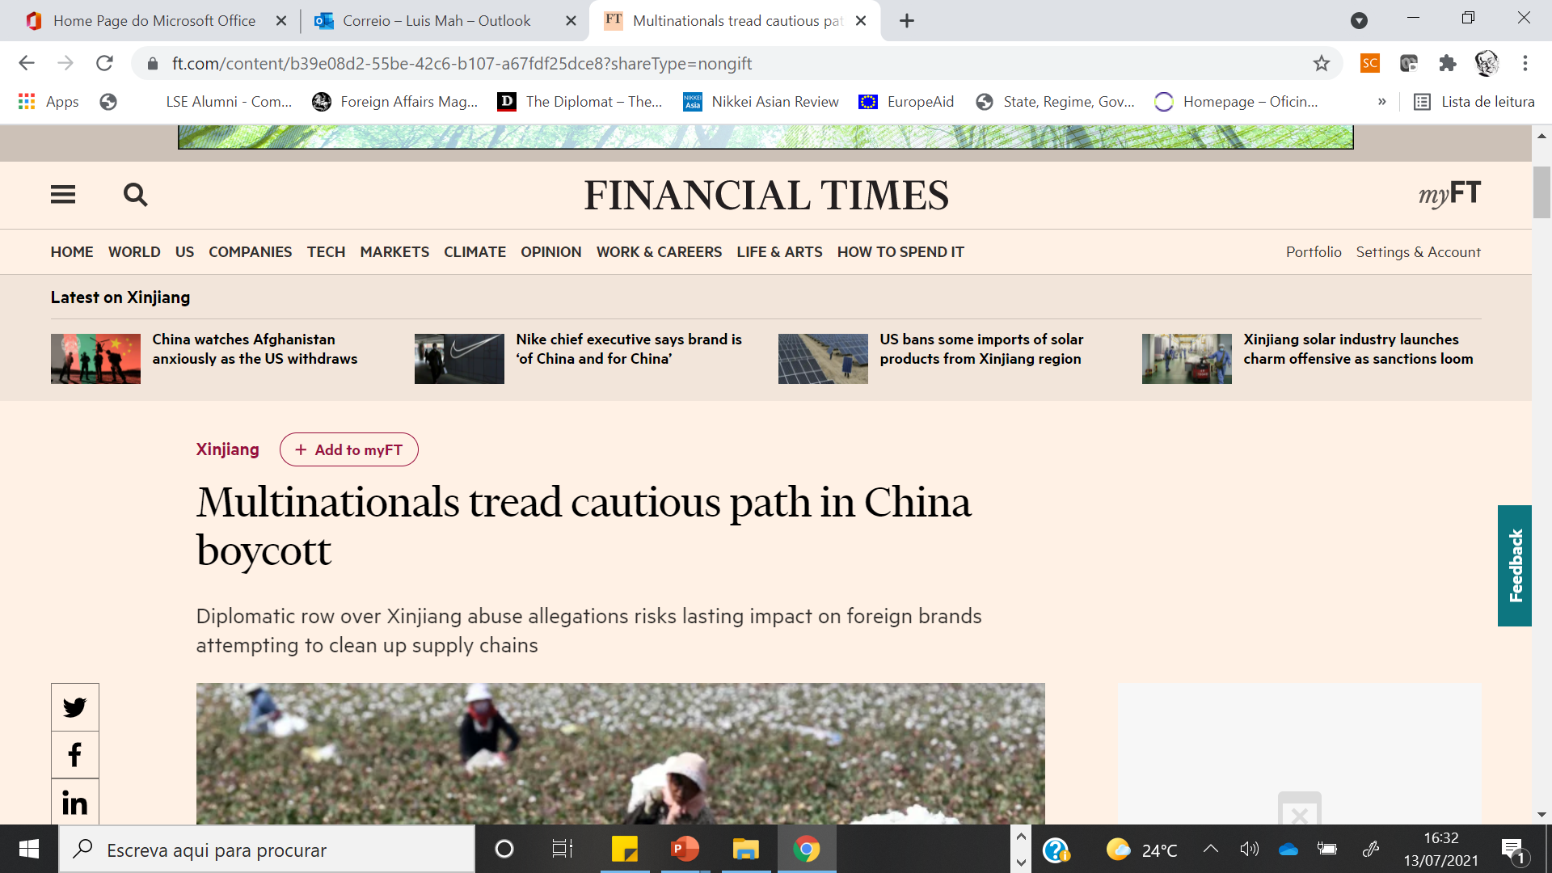

Slide 35
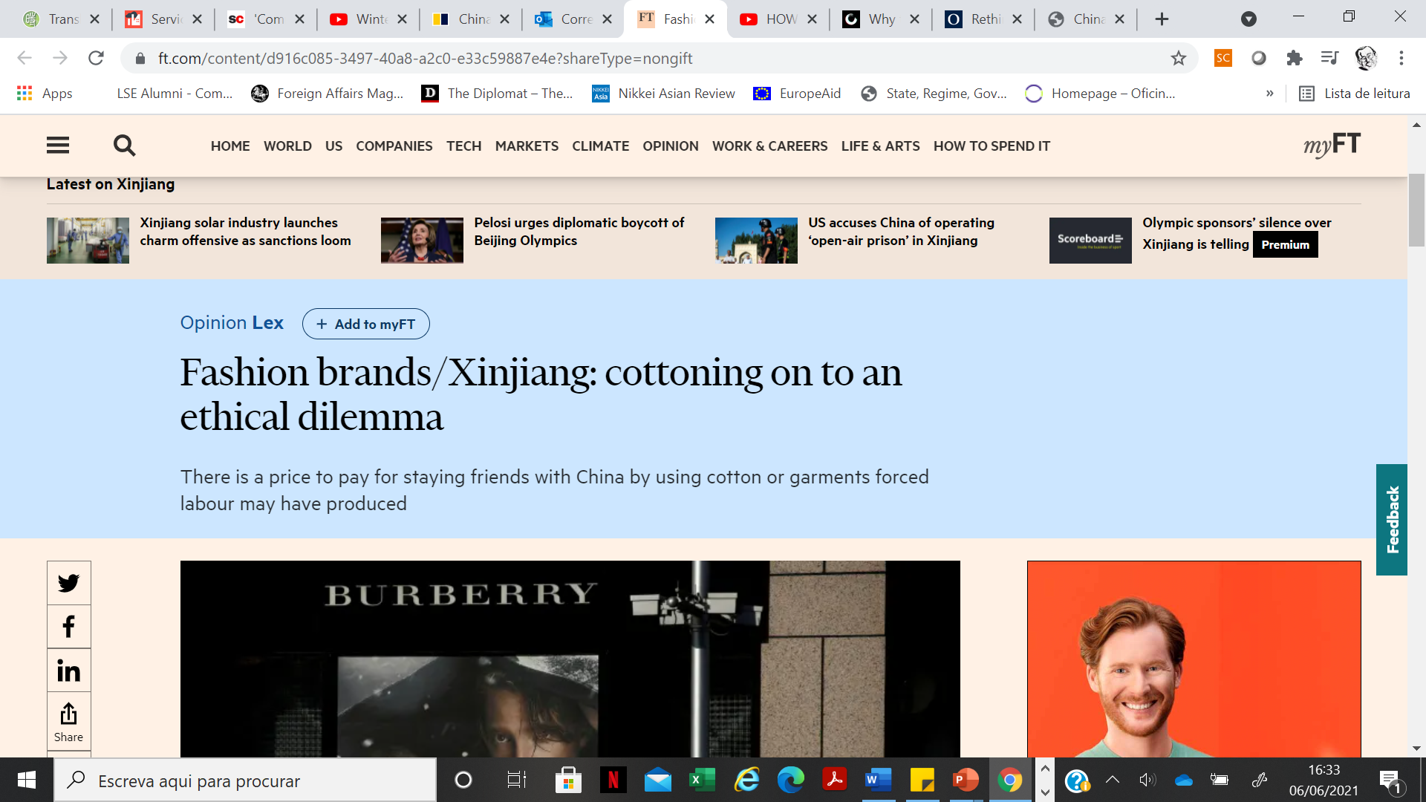

Slide 36
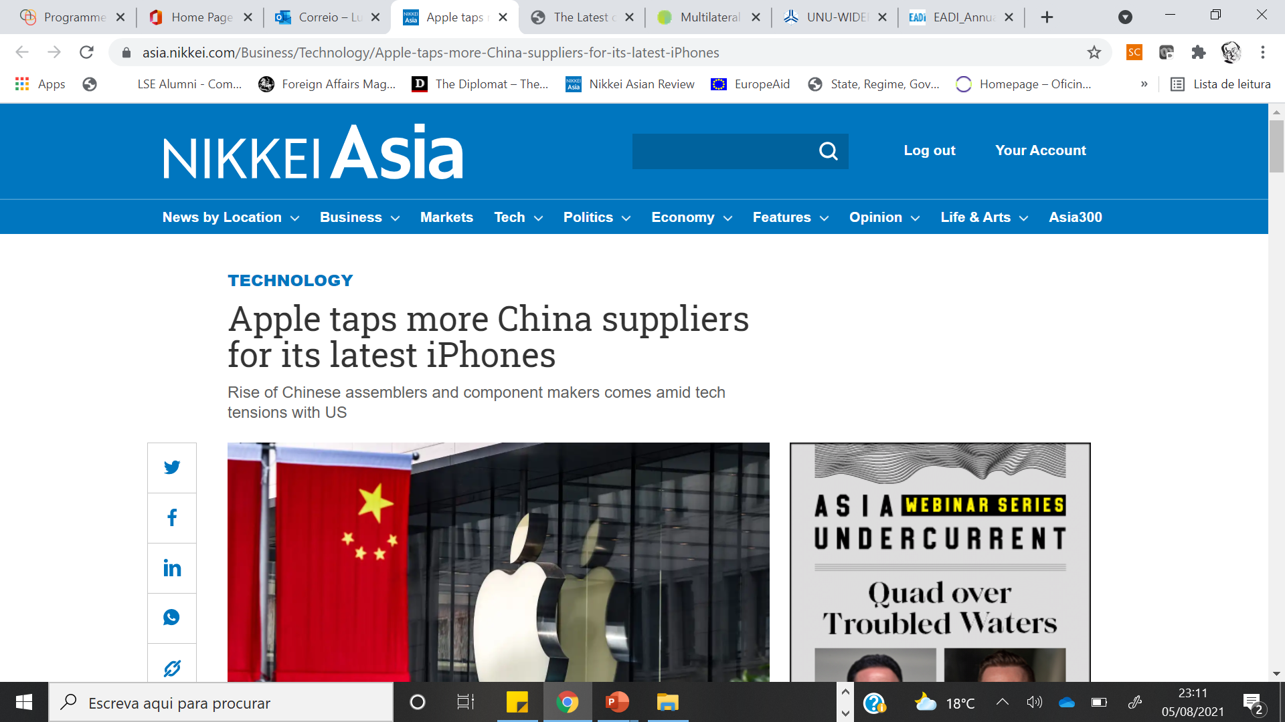

Slide 37
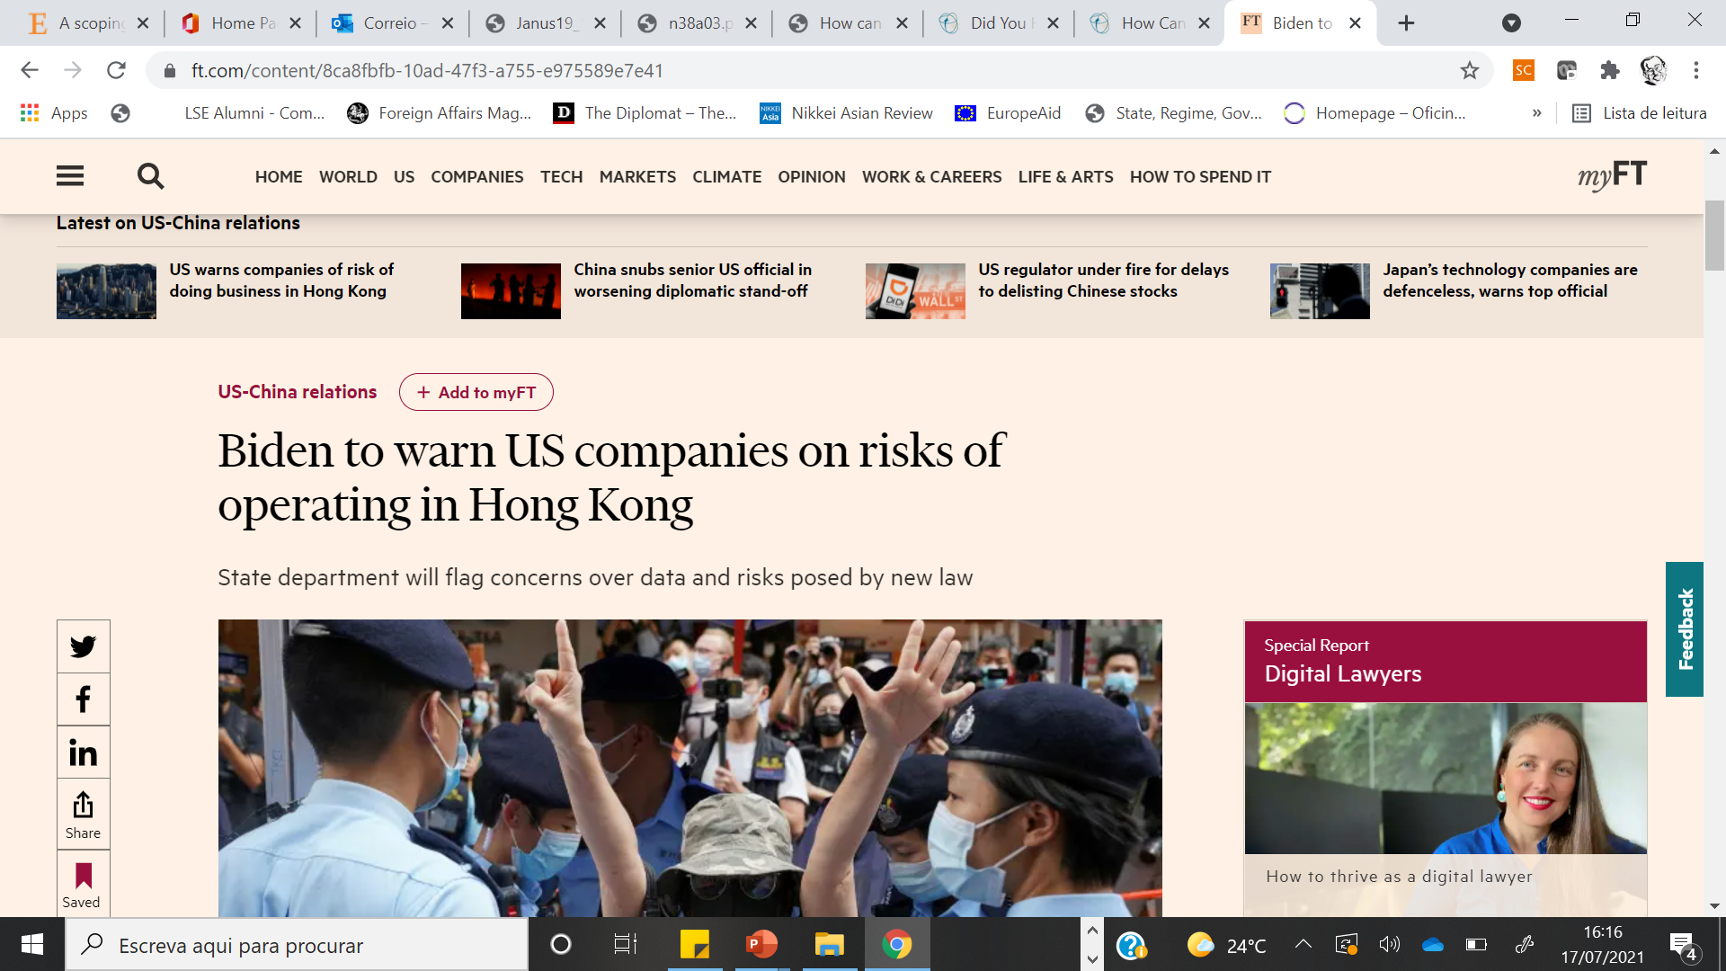

Slide 38
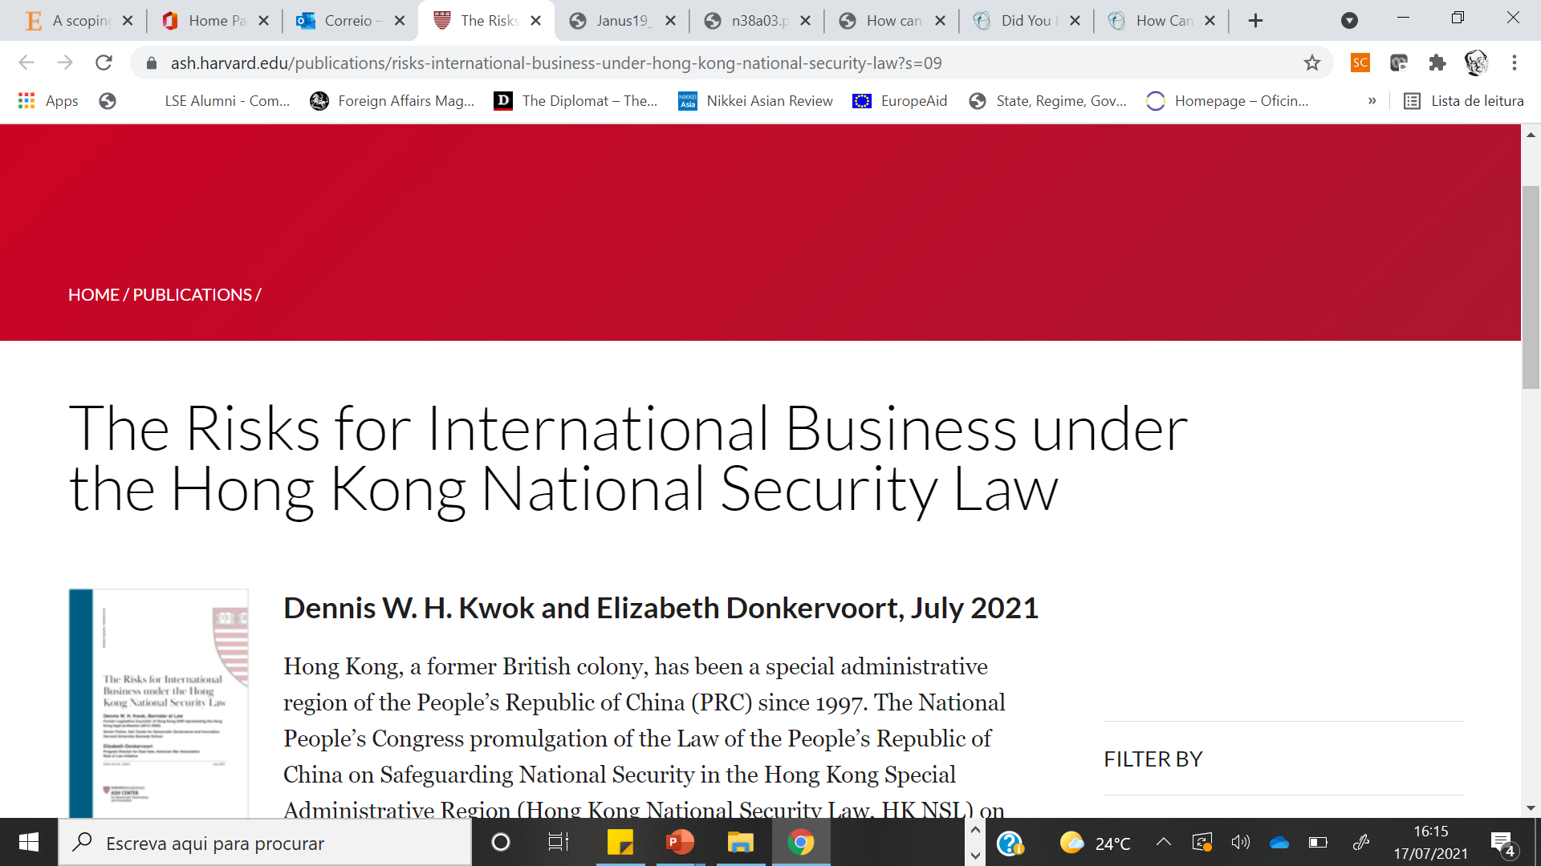

Slide 39
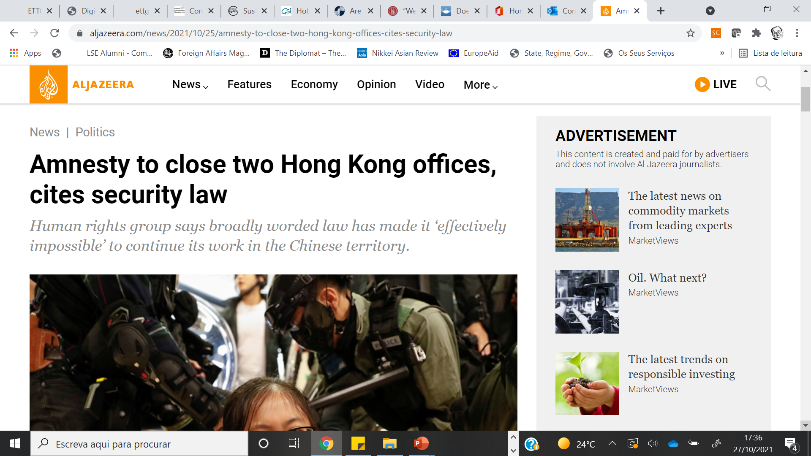

Slide 40
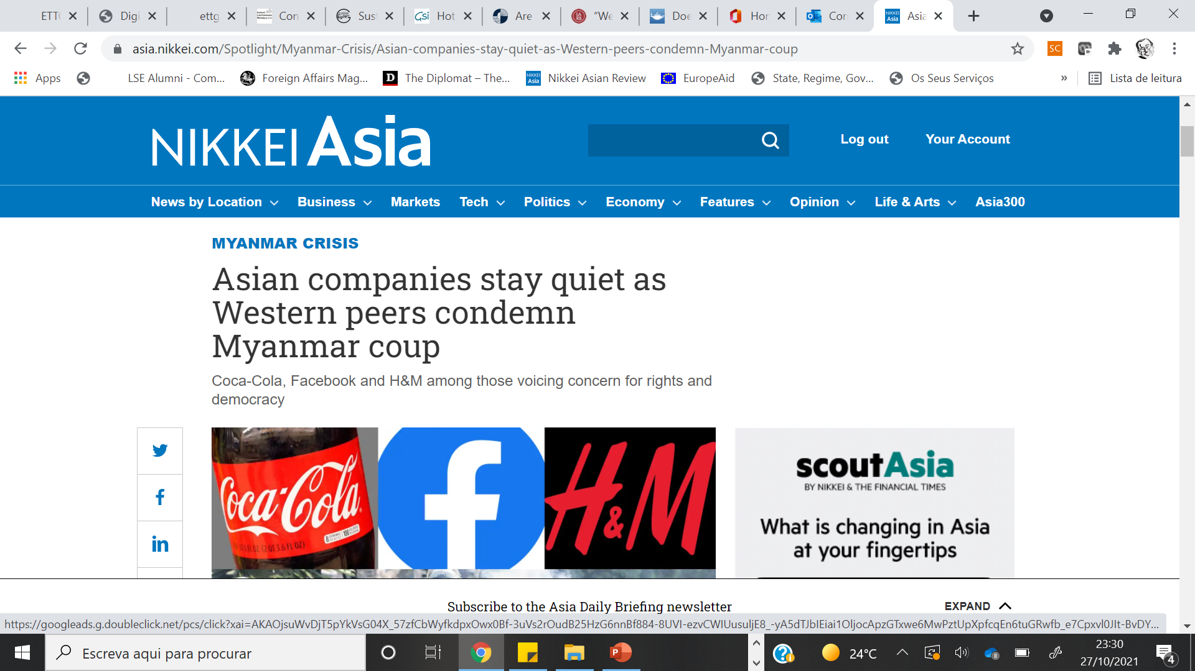

Slide 41
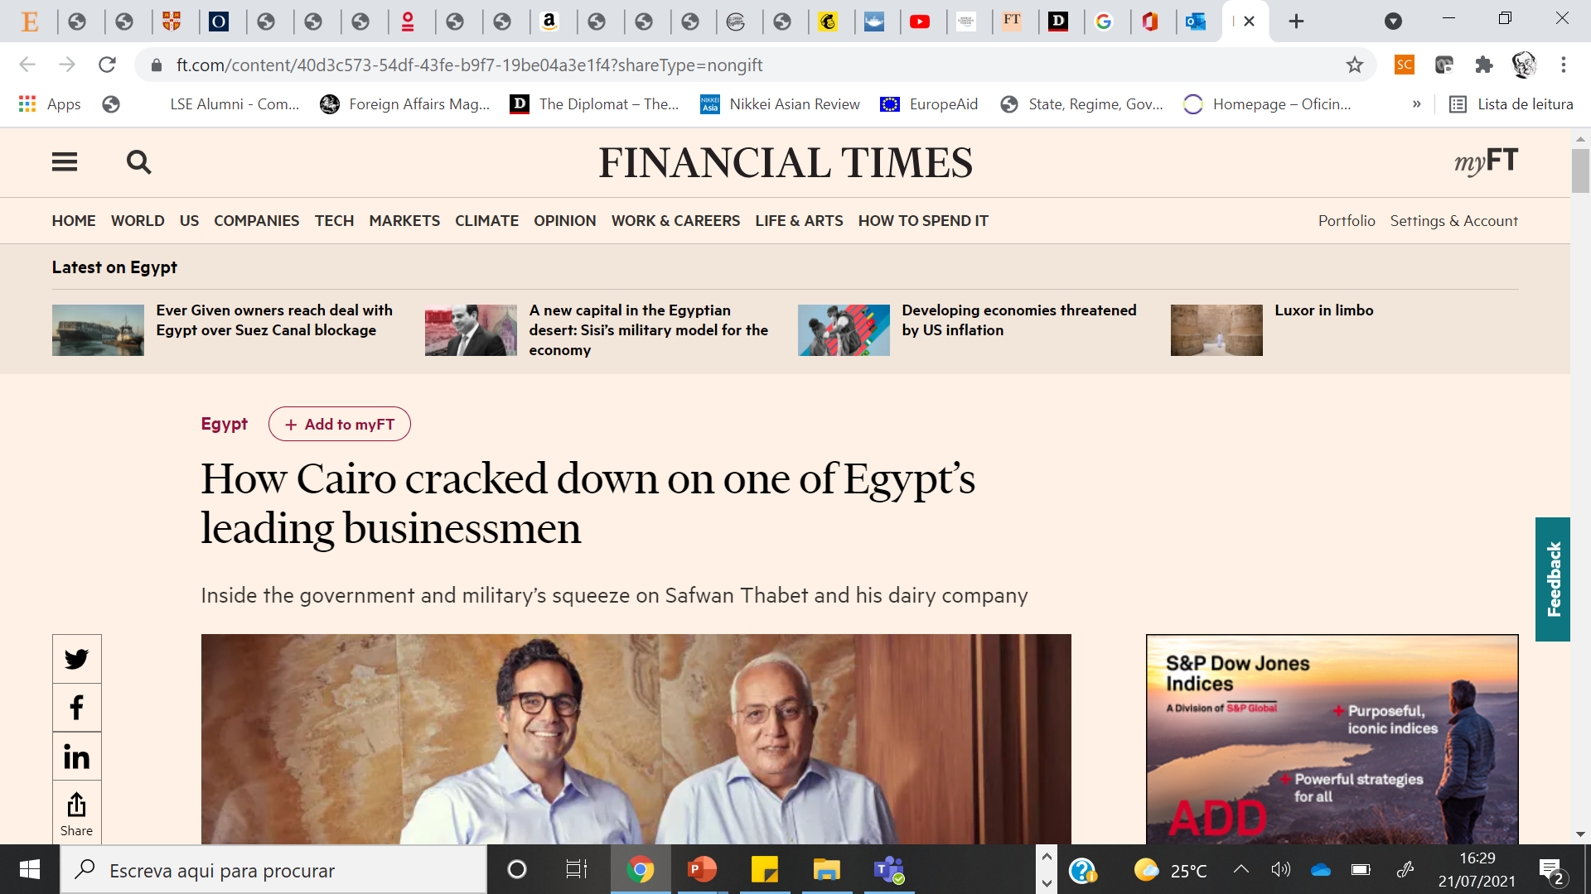

Slide 42
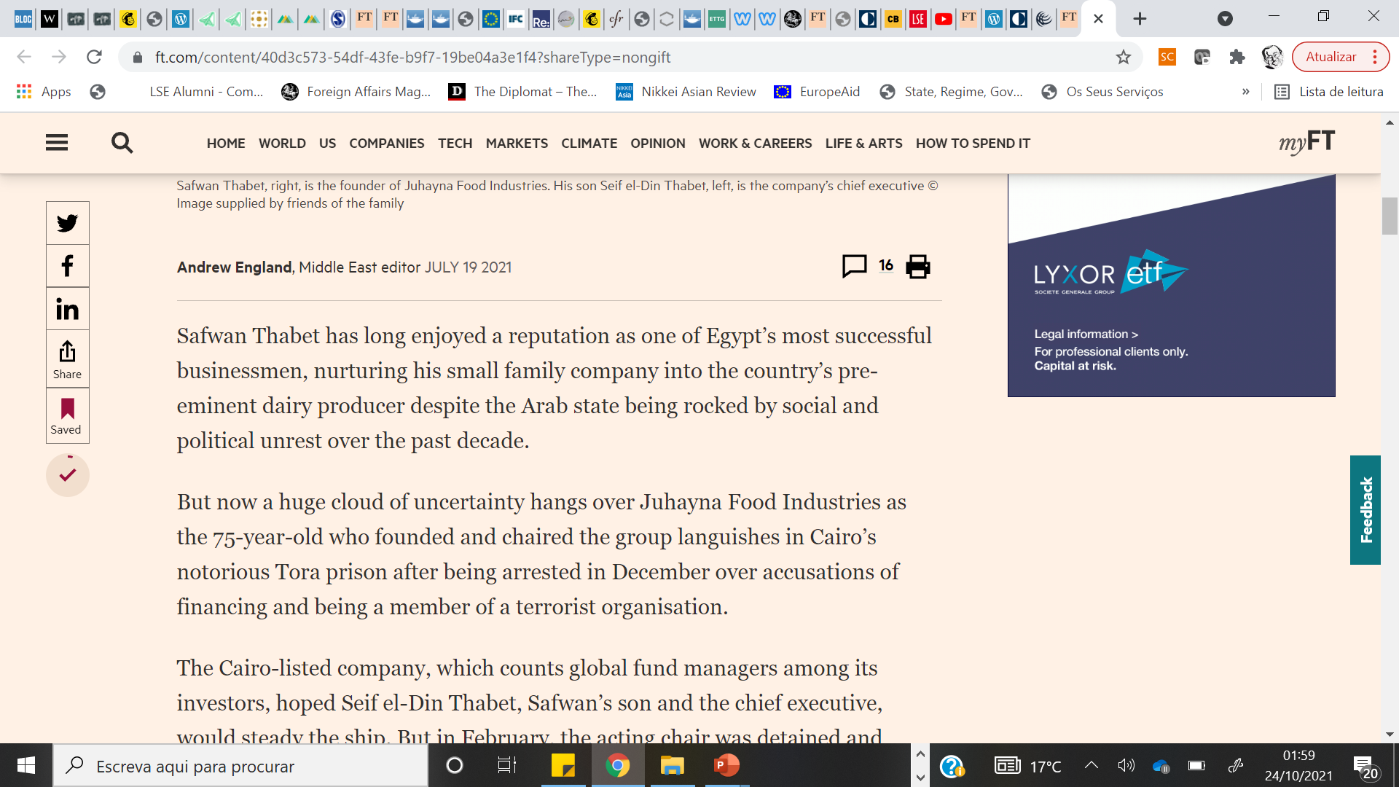


Slide 43
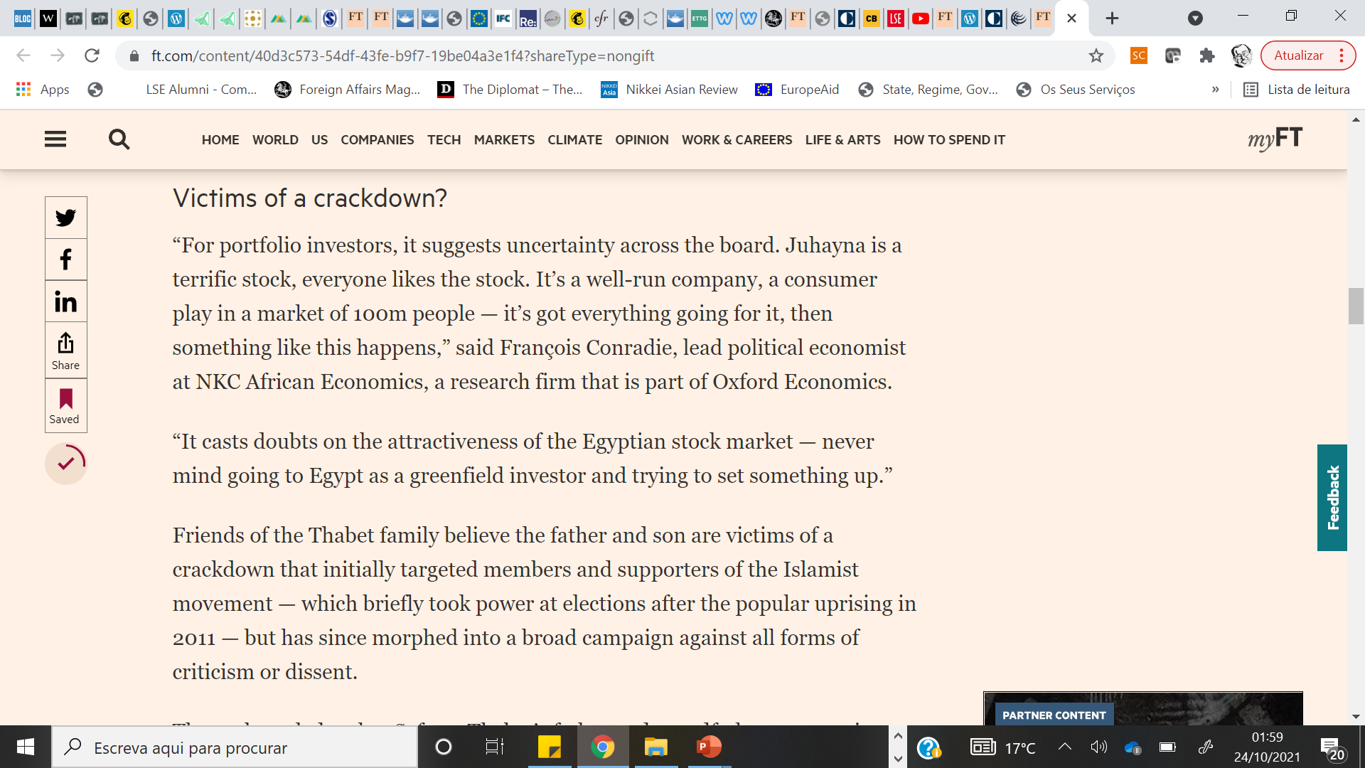

Slide 44
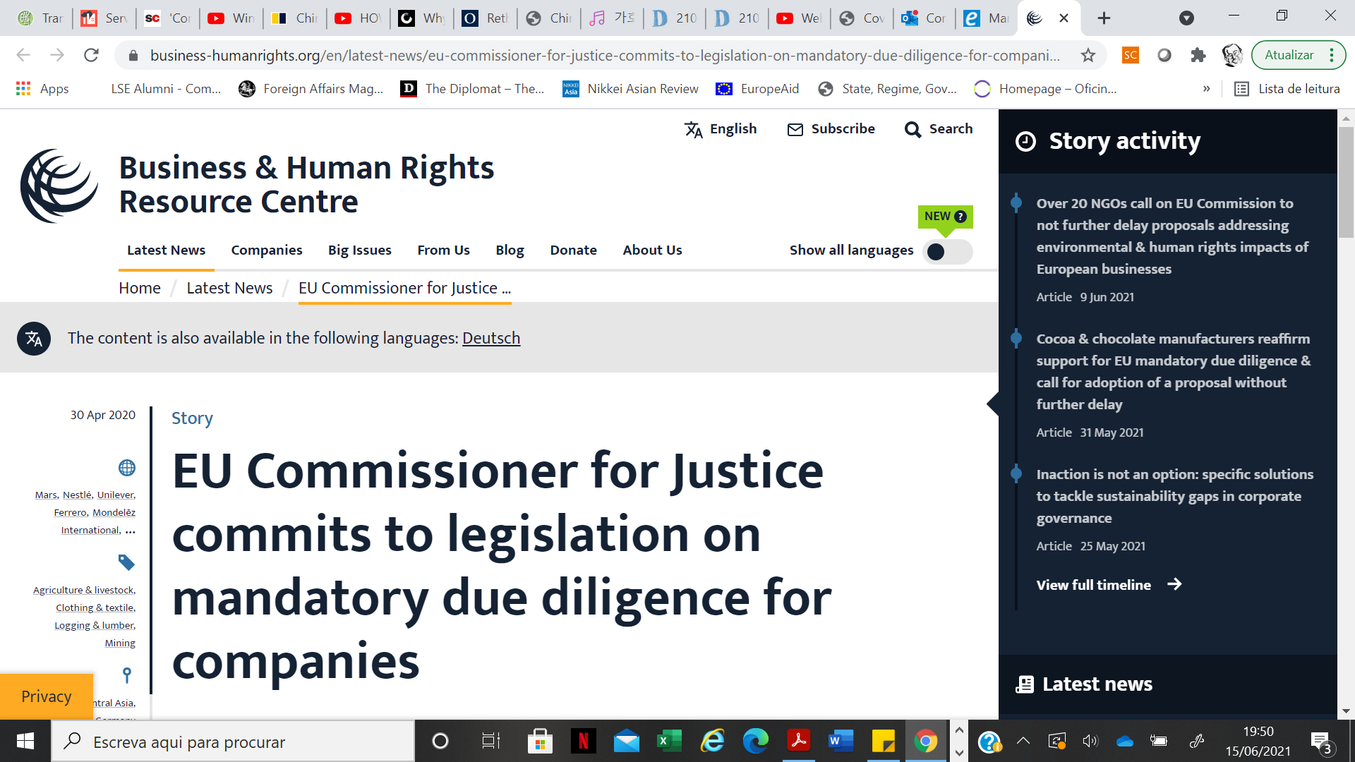

Slide 45
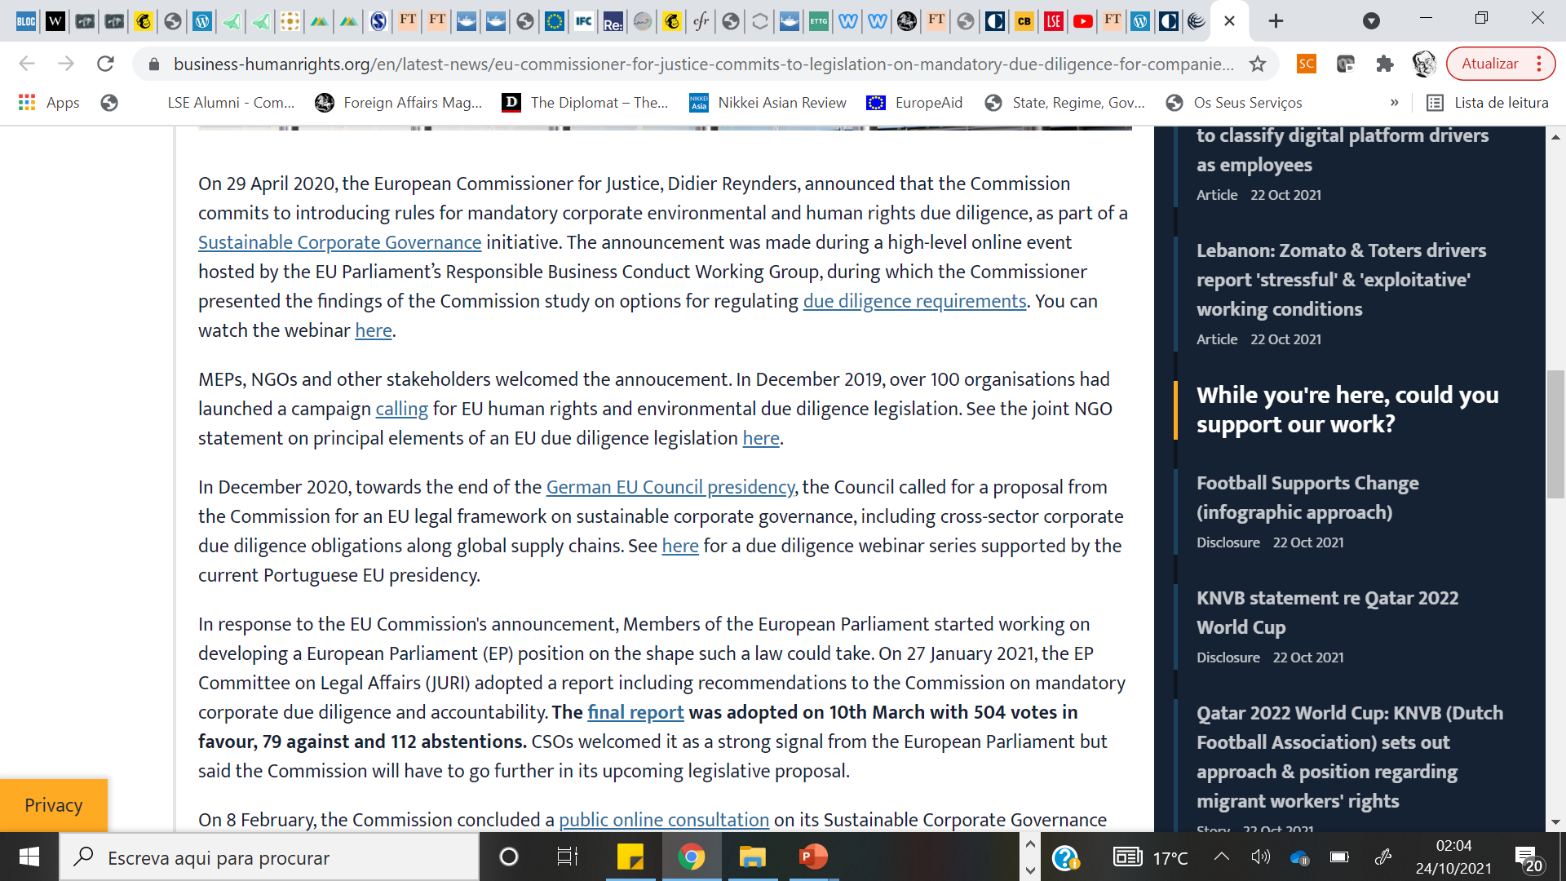

Slide 46
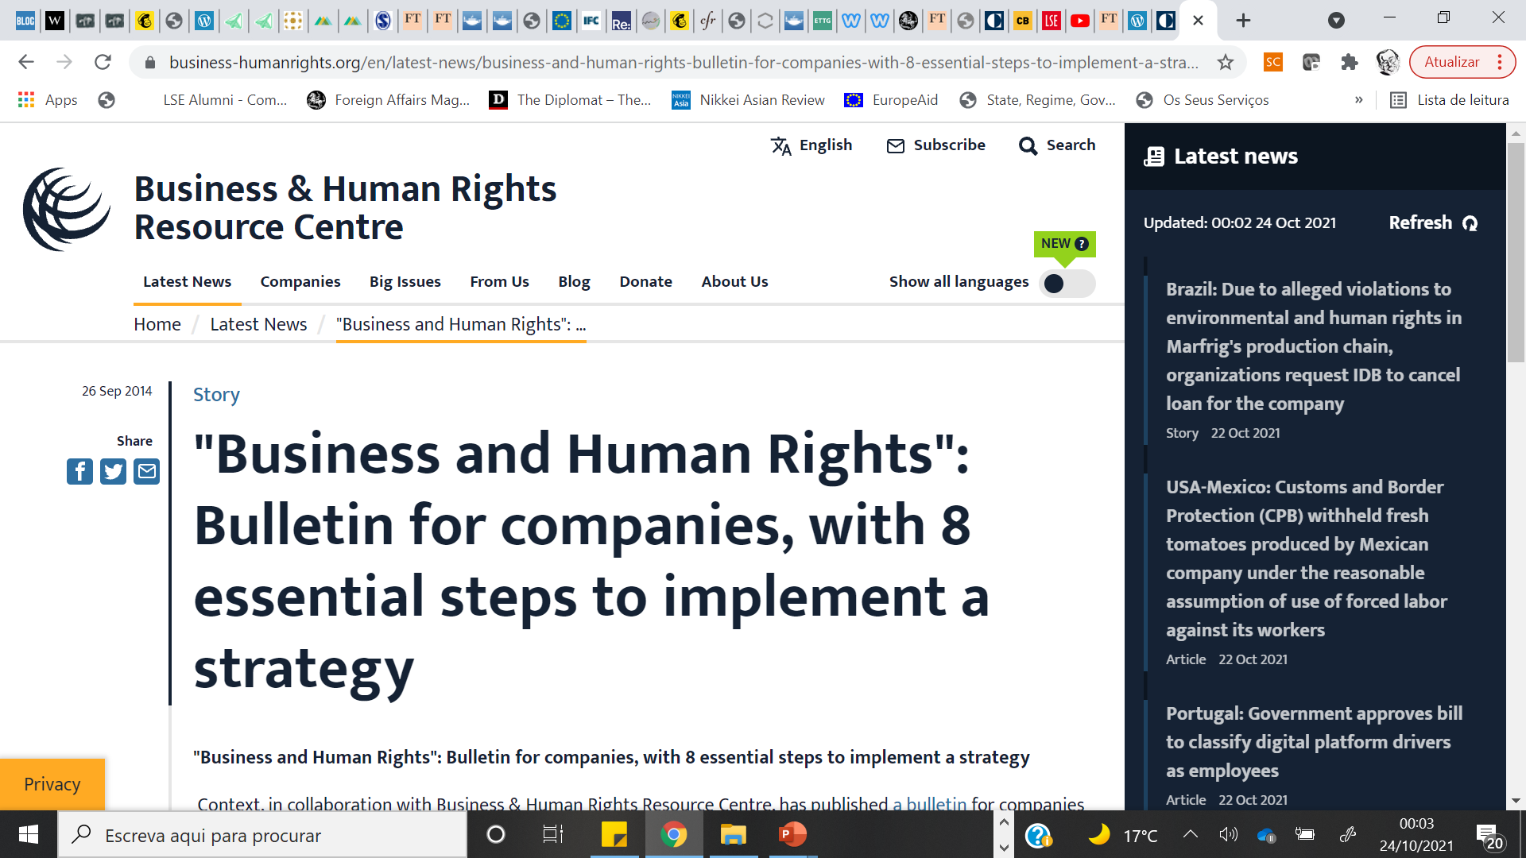

Slide 47
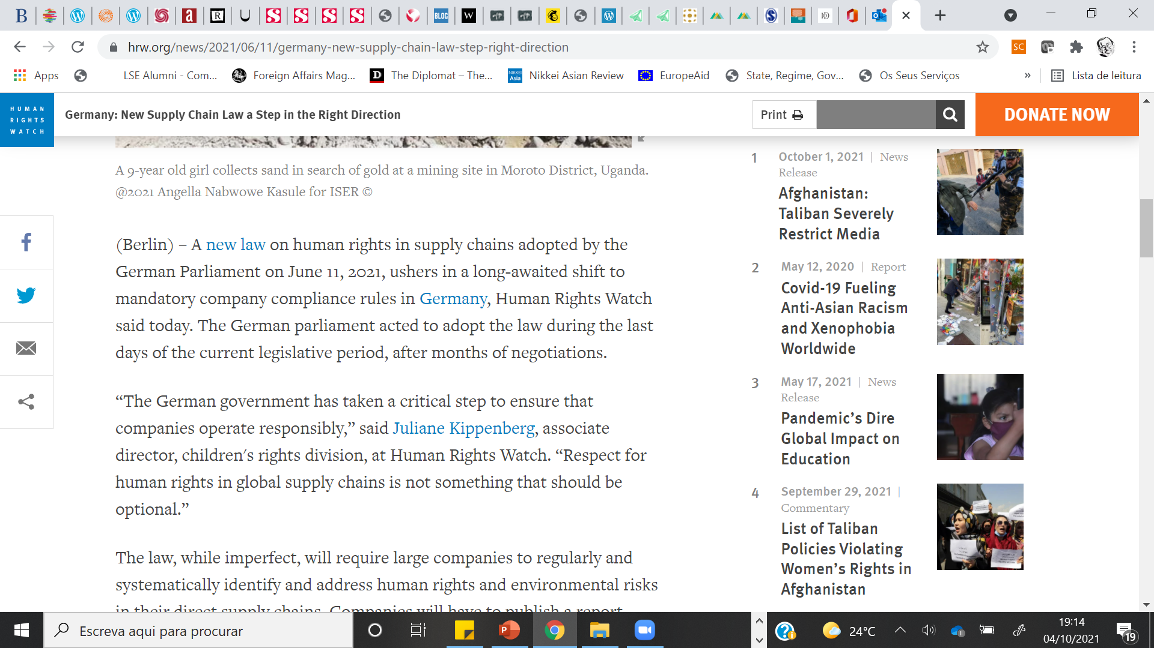

Slide 48
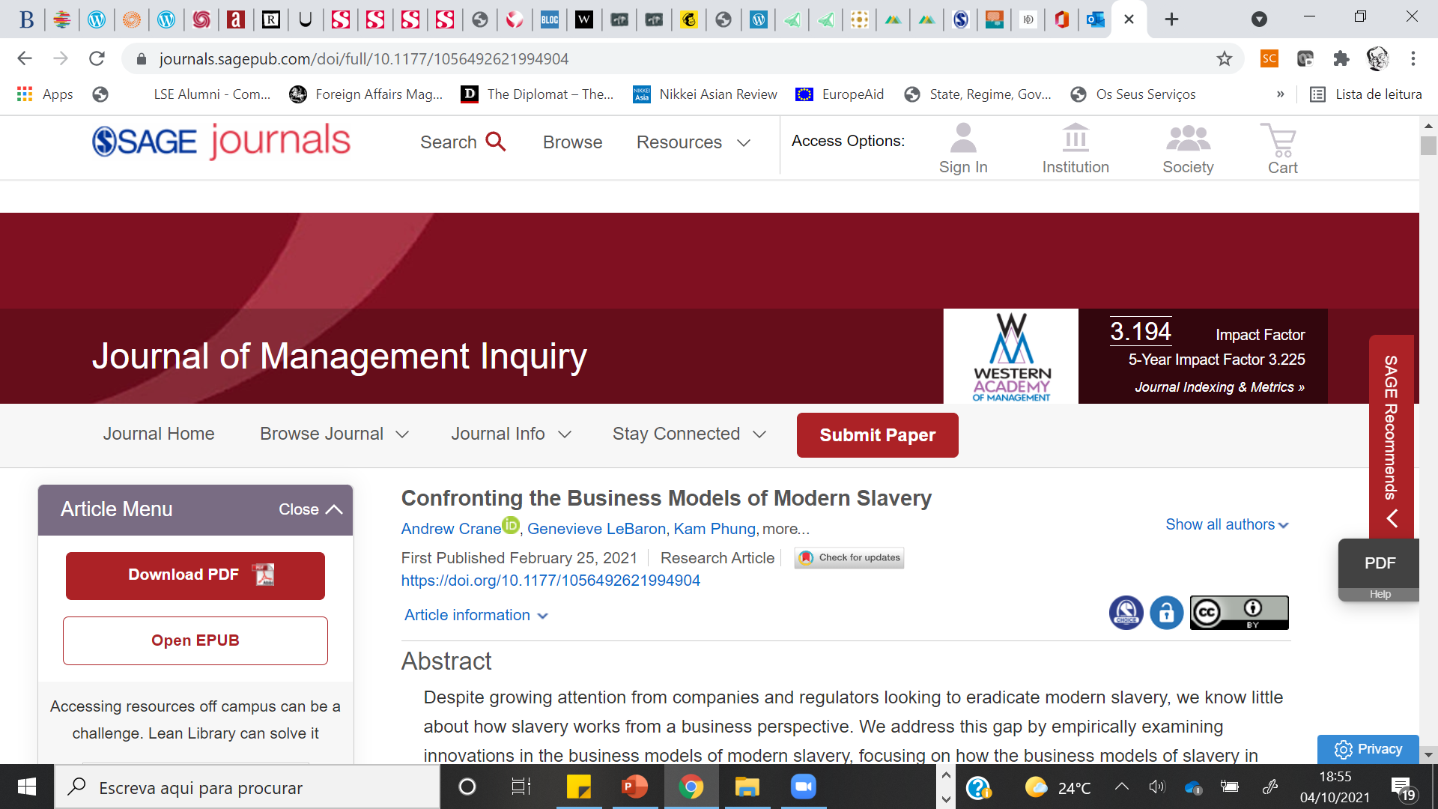

Slide 49
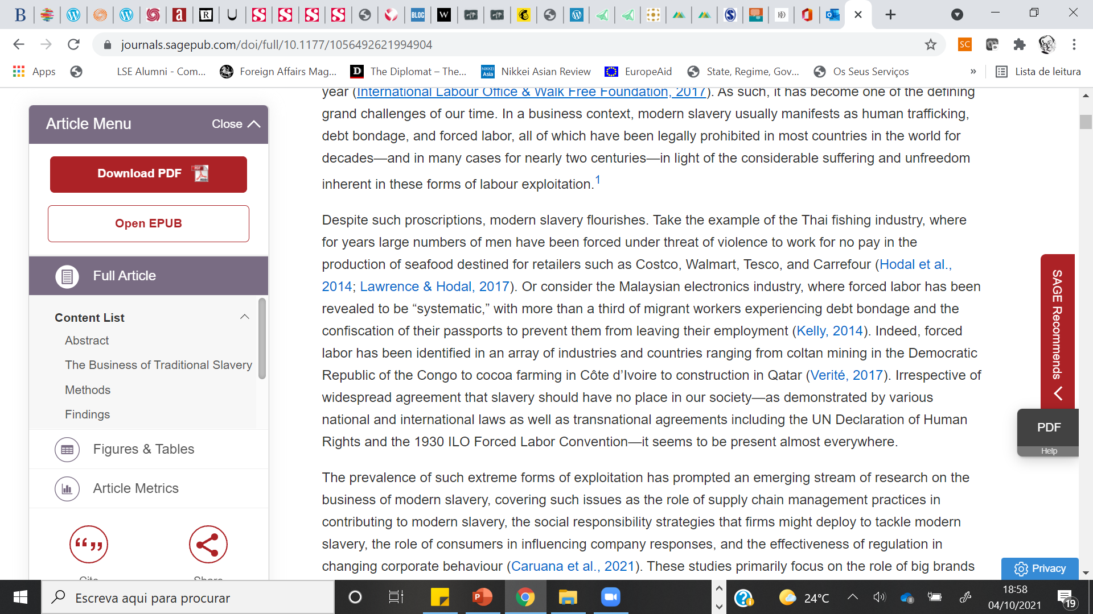

Slide 50
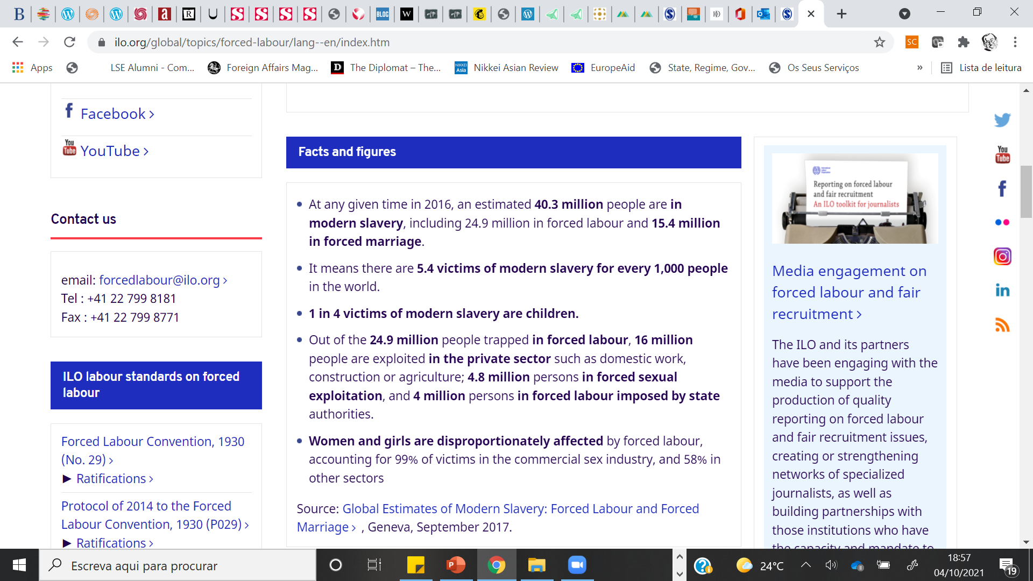

Slide 51
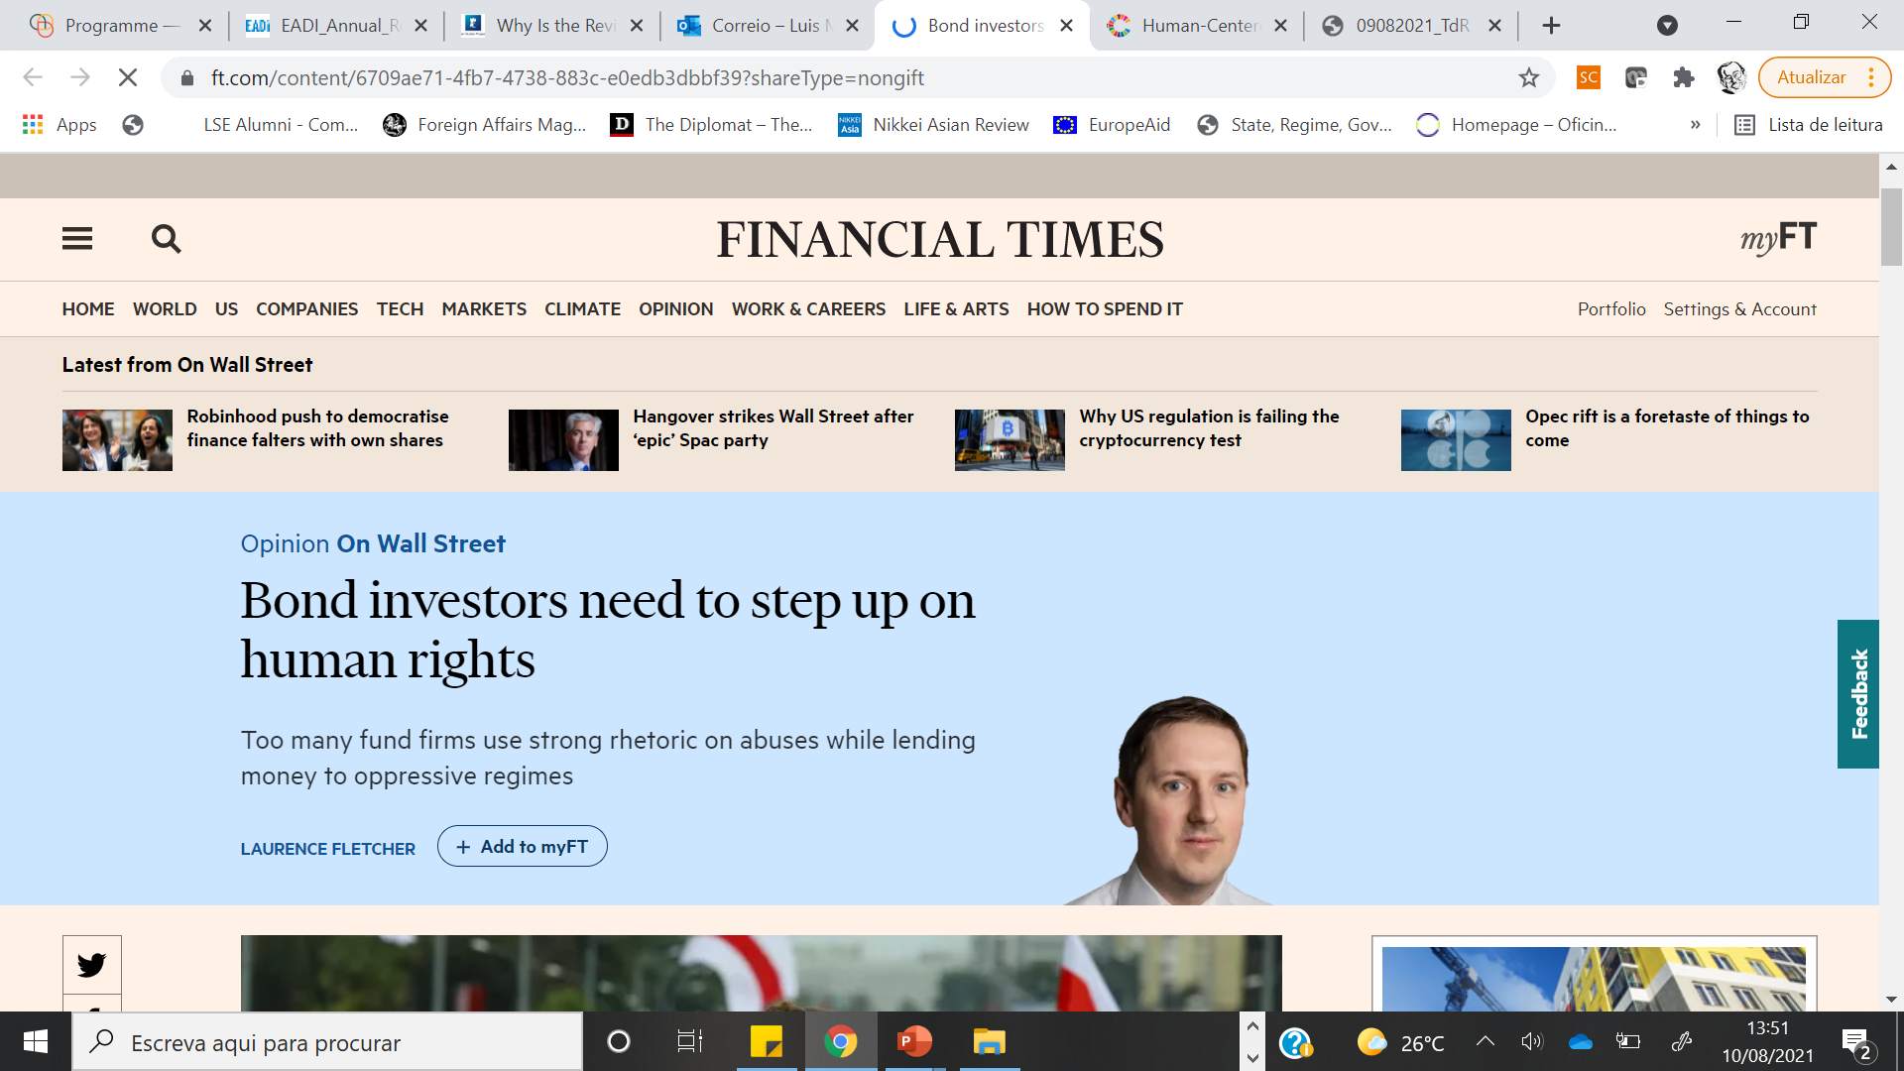

Slide 52
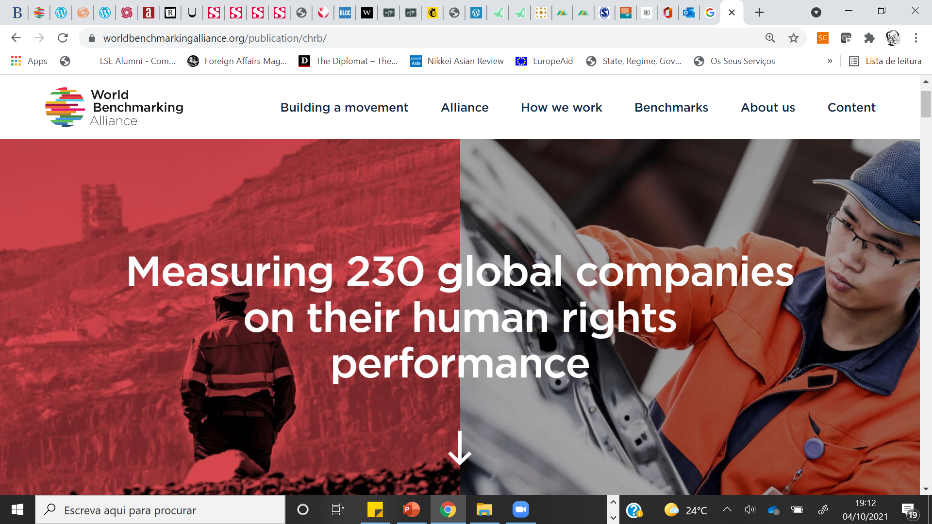

Slide 53
THE GET PODCAST
-» The purpose of this assignment is for you to demonstrate the ability to discuss ESG and its future within the global financial system. You will be given a letter written by Tariq Fancy, a former CIO of BlackRock, on his views on ESG following his leave from the main asset management firm in the world. Here: https://medium.com/@sosofancy/the-secret-diary-of-a-sustainable-investor-part-1-70b6987fa139
-» You are expected to carry out some level of research on the issue at hand and collect the relevant data, analyse the ongoing debate on ESG.

Slide 54
THE GET PODCAST
Format
-» You are asked to submit 1 audio file and the script of your audio.
-» Your audio podcast should contain the following sections:
(1) an introduction presenting ESG
(2) an analysis of the debate on the pros/cons of ESG
(3) Your own view on ESG
(4) a conclusion
The podcast should last no more than 15 minutes.
Audience (everybody?): We should be able to listen to the podcast in a language that is concise, clear, concrete and to the point, without any financial jargon.

Slide 55
THE GET PODCAST
Assessment criteria
Clarity, coherence of the argument
Creativity (effort to make podcast interesting, fun, entertaining; evidence of creative thinking)
You are allowed to use music or effects in the podcast but you do not have to. You will not be assessed on the technical aspects of the podcast as such (audio quality, etc), but making it exciting and interesting will definitely help the podcast be more appealing to listen to.

